Slide 1
Characterizing and Determining the Influence of Soil Compactness on Microbial Communities and Soil Classifications
Negar Zaghi
31094139

Slide 2
Content
General: for presentation, write the research questions clearly in the slides for each analysis because we have a lot of research questions
Introduction
Research Focus
Alpha Diversity
Beta Diversity
Core Microbiome
Indicator Taxa
Differential Abundance
Correlation Analysis

Slide 3
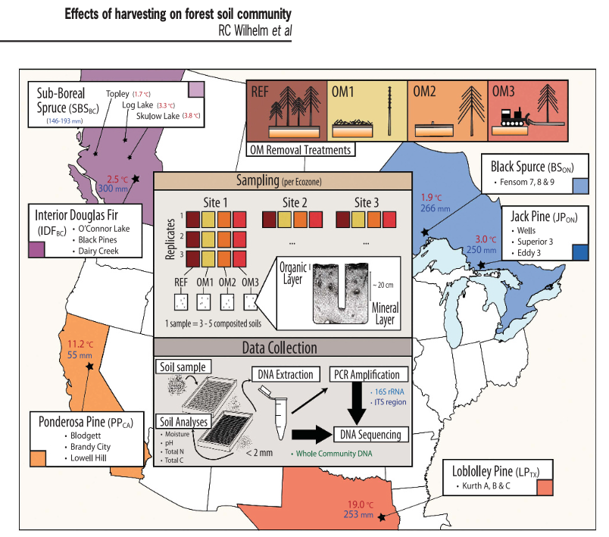
Soils collected from 18 reforested LTSP sites (11-17 years old)
3 sites per ecozone
Each sites included samples with three harvested treatment with varying degrees of Organic Matter (OM) removal.
Did microbial and various soil analyses
Talk about why you chose to look at compaction
Conclusions:
- OM removal treatments had a relatively small, though significant (Po0.01), effect on overall bacter- ial and fungal beta-diversity
Notes:
REF: Unharvested reference
OM1: Where tree boles (stems) were debranched and removed, leaving woody debris in place
OM2: Where whole trees including branches were removed
OM3: Where whole trees were removed and the upper organic layer of forest floor scraped away
Conclusions:
Removal of forest floor (OM3) had the greatest impact on the soil community by nearly all measures.
The ecozone-specific impacts of harvesting on microbial communities is consistent with the variability in forest productivity reported in other LTSP publications
Changes resulting from harvesting were relatively minor in comparison to the variability between soil layers and among geographic regions.
However, the relative magnitude of ostensibly unaffected populations may be inflated due to substantial presence of relic DNA in soil
Limitations: Yet, at present, our understanding of the contributions of soil communities to forest productivity and succession is limited. This limited understanding was highlighted in our study by the increased proportion of unclassifiable OTUs in harvested plots. The full extent of the impact of harvesting on soil communities cannot be known until those knowledge gaps are filled.

Slide 4
Research Gap: Determine the impact of soil compaction on microbial communities within different soil classifications
Notes:
Past publications in UJEMI:
Past publications in the Undergraduate Journal of Experimental Microbiology and Immunology (UJEMI) that have used this dataset have primarily explored the relationships between abiotic soil factors and treatments related to soil microbial diversity (11-15). Some abiotic factors investigated included soil moisture, pH and soil acidity (11-15). Furthermore, the majority have only looked at the British Columbia sampling sites, specifically the Interior Douglas-fir region. These publications have also found weak and inconsistent relationships between soil abiotic factors, organic removal intensity and soil properties at reforested sites in relation to microbial diversity.

Slide 5
Alpha Diversity:
What is the alpha diversity of the various soil classifications and compaction levels?
Notes:
Control by Ecozone and Harvesting Treatment

Slide 6
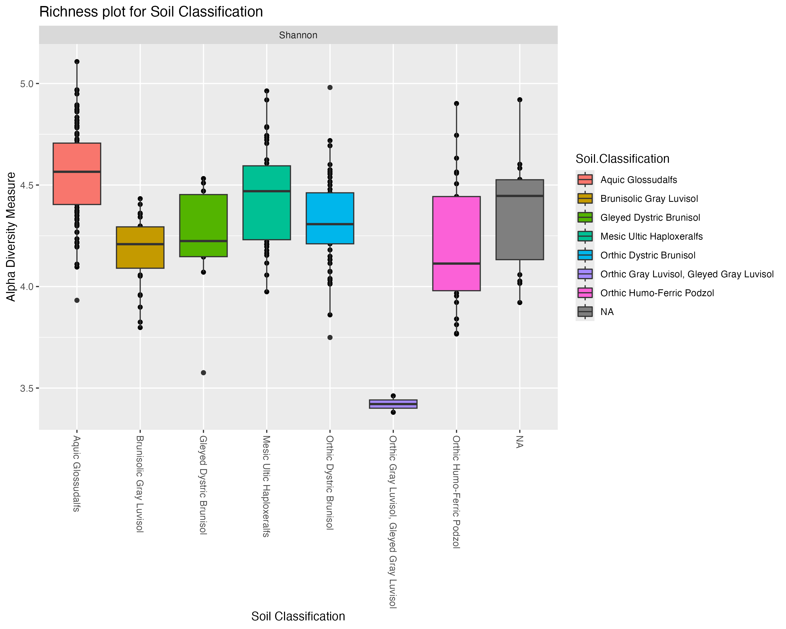
Alpha Diversity - Richness and Evenness Soil Classification Not controlled for other variables
Compare this with the phylogenetic distance and comment on why they trends are the same. Both richness/evenness and phylogenetic distances show alpha diversity in a similar way

Slide 7
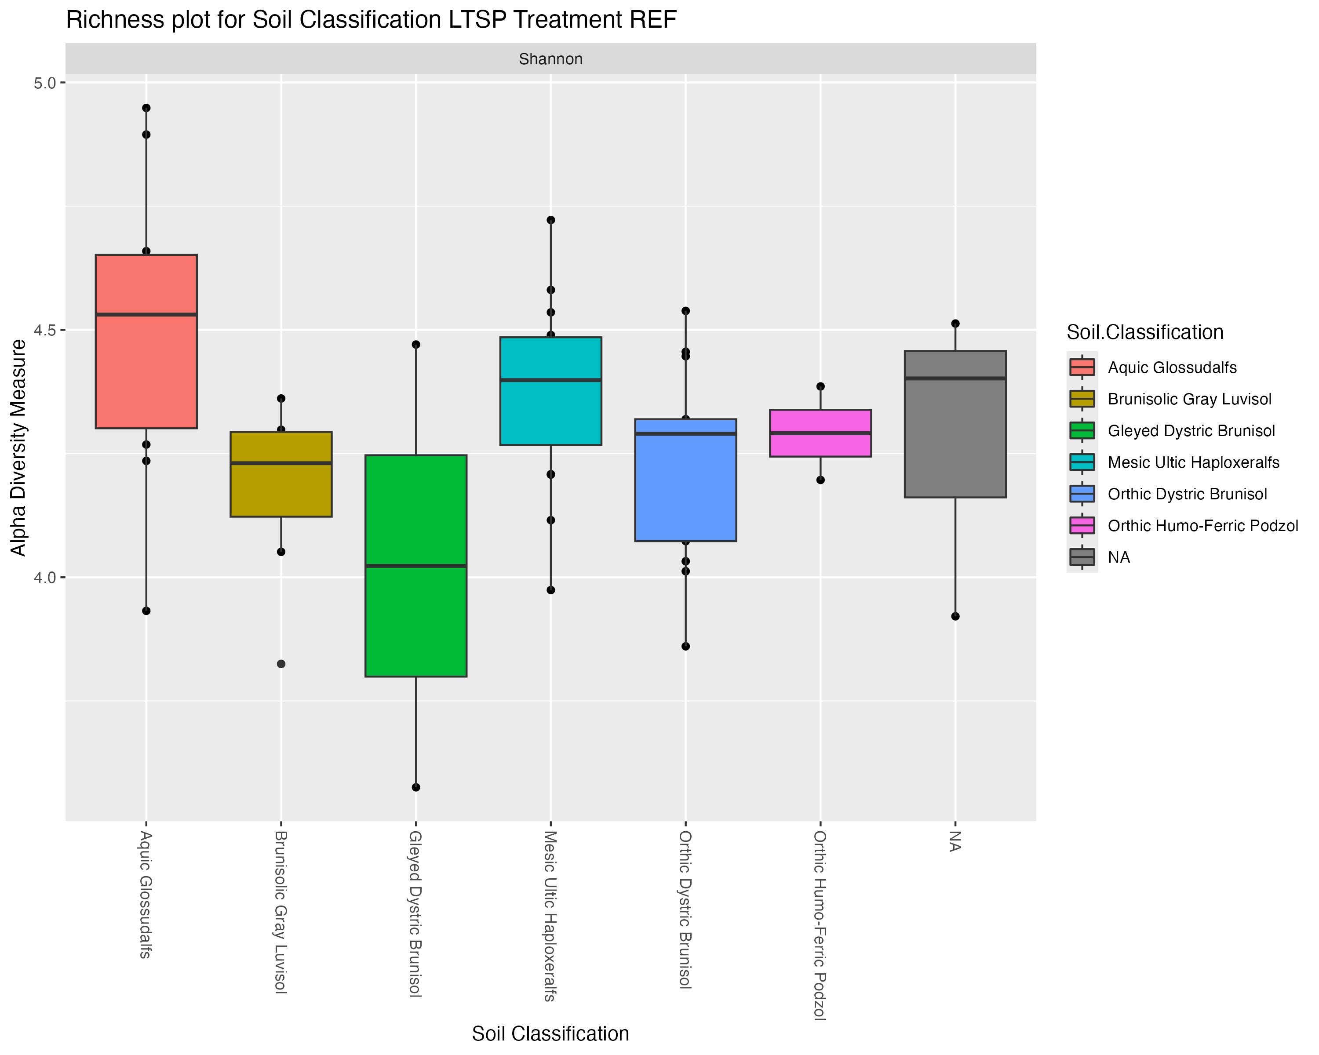
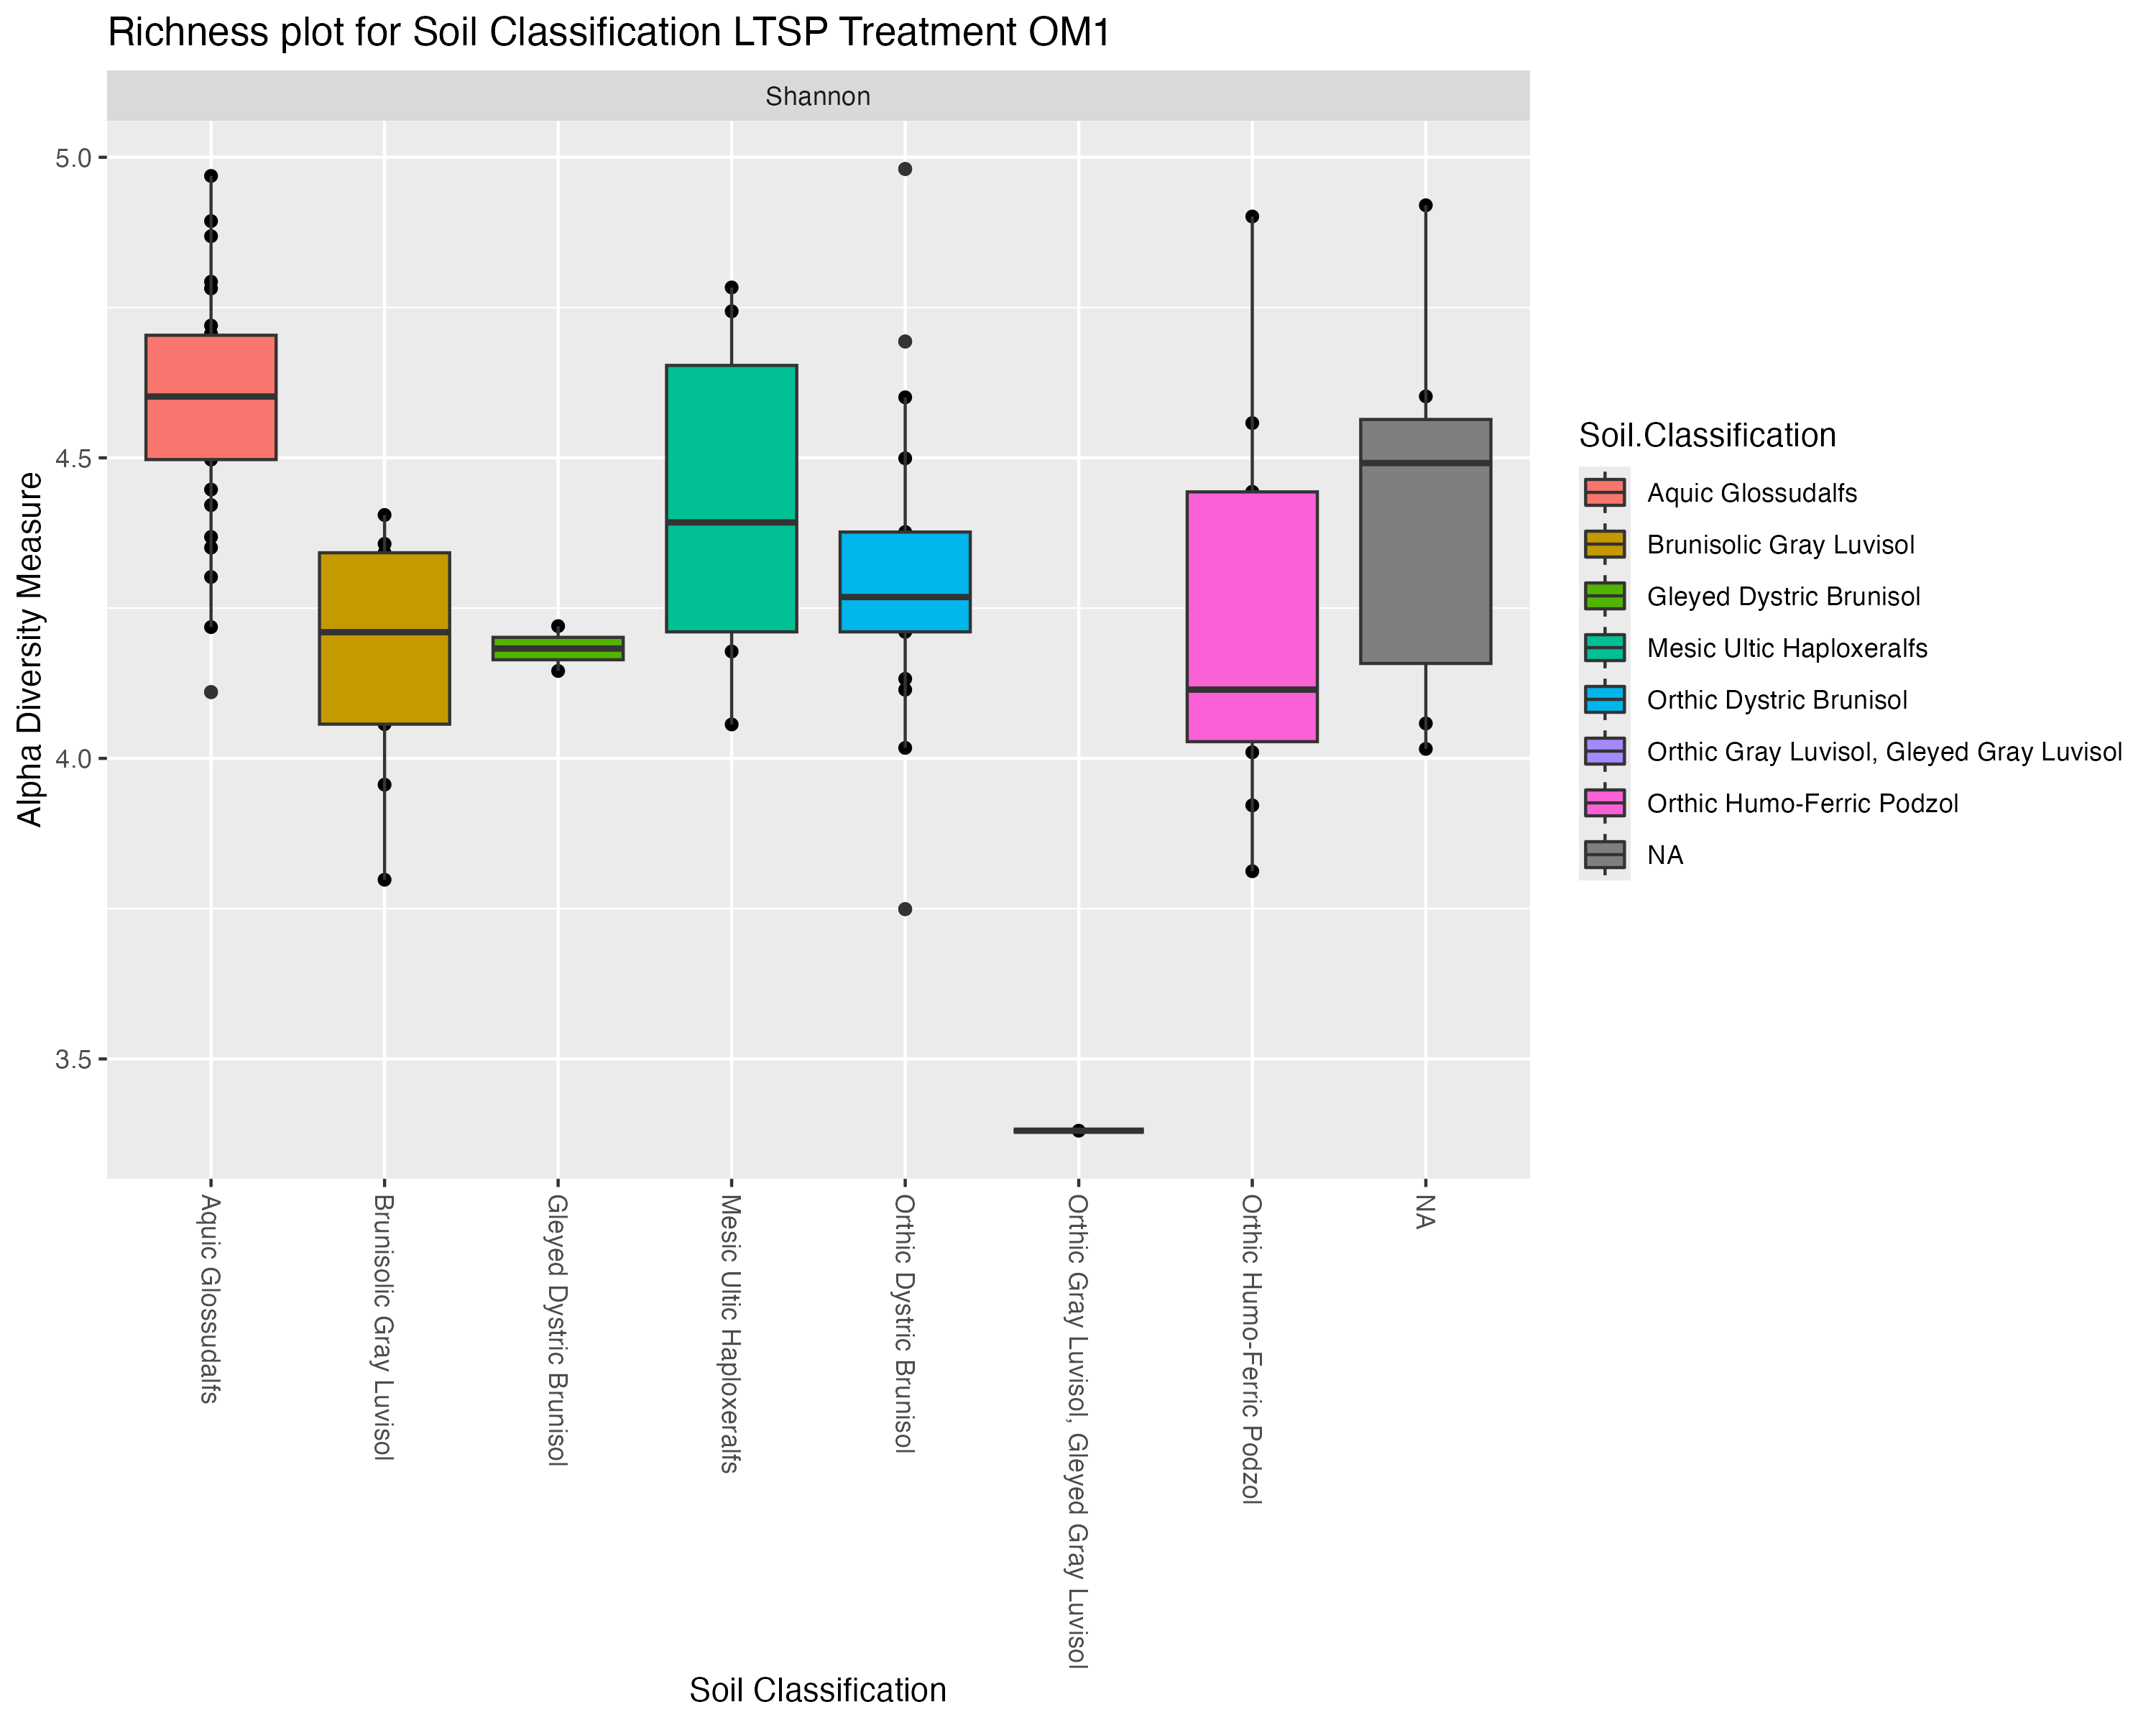
Alpha Diversity Richness – Controlled for LTSP Treatment
REF
Make all the plot legends and axis larger and easier to read. Also make the color pallet color blind friendly
OM1
Plot 1: 4 panels, shannons only
Do K-W analysis

Slide 8
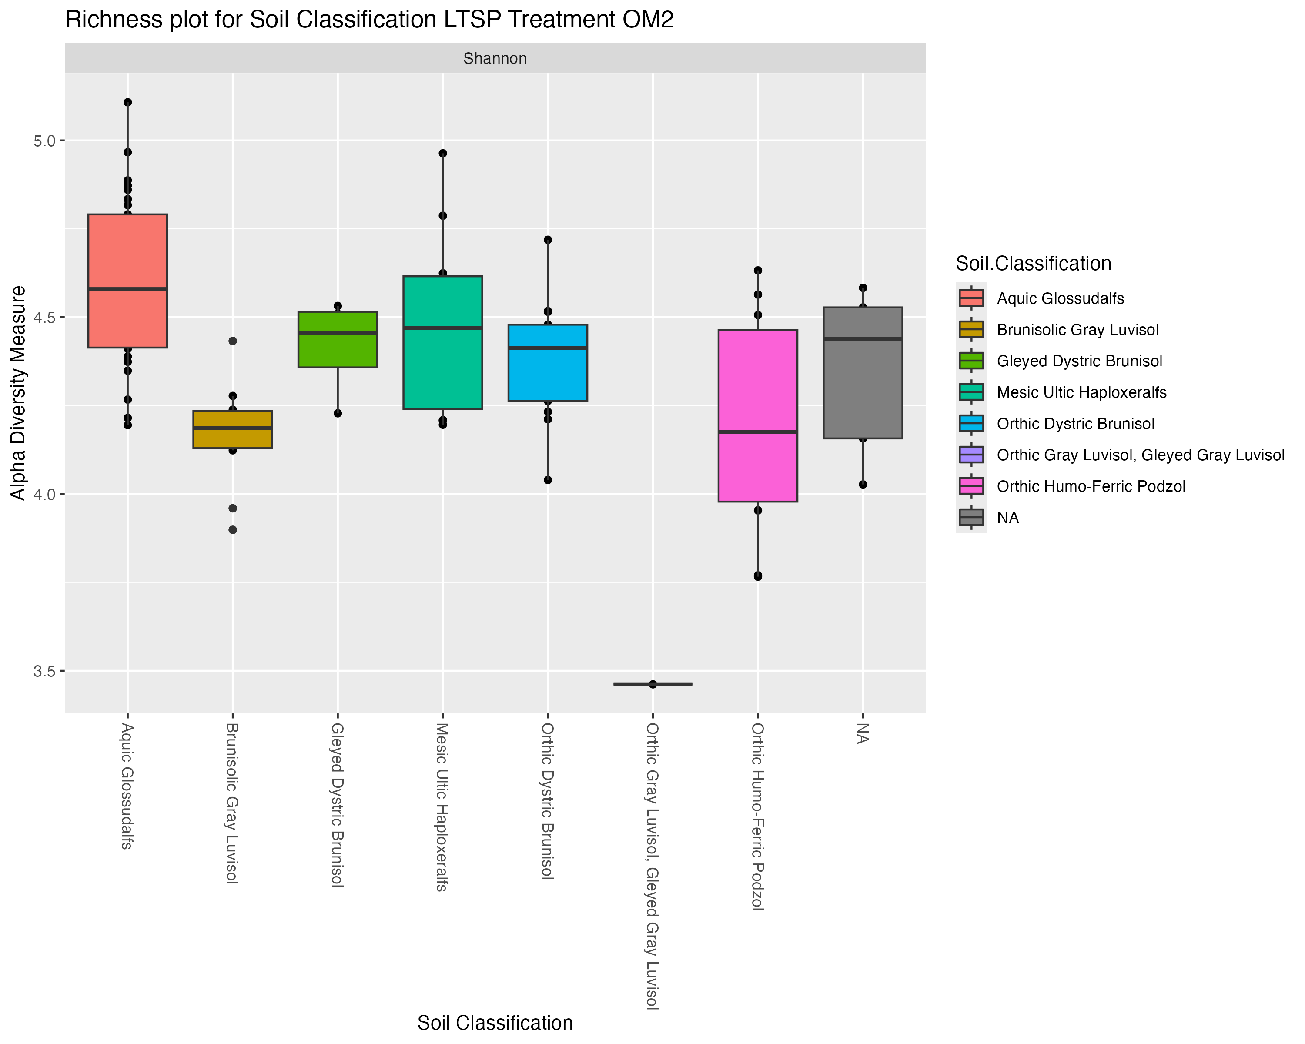
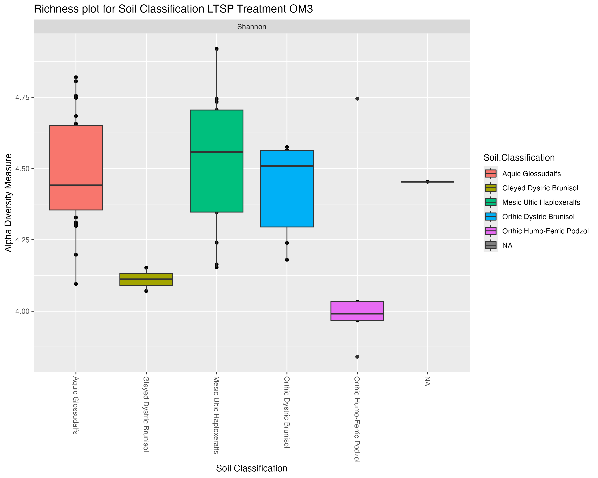
Alpha Diversity Richness – Controlled for LTSP Treatment
OM2
OM3

Slide 9
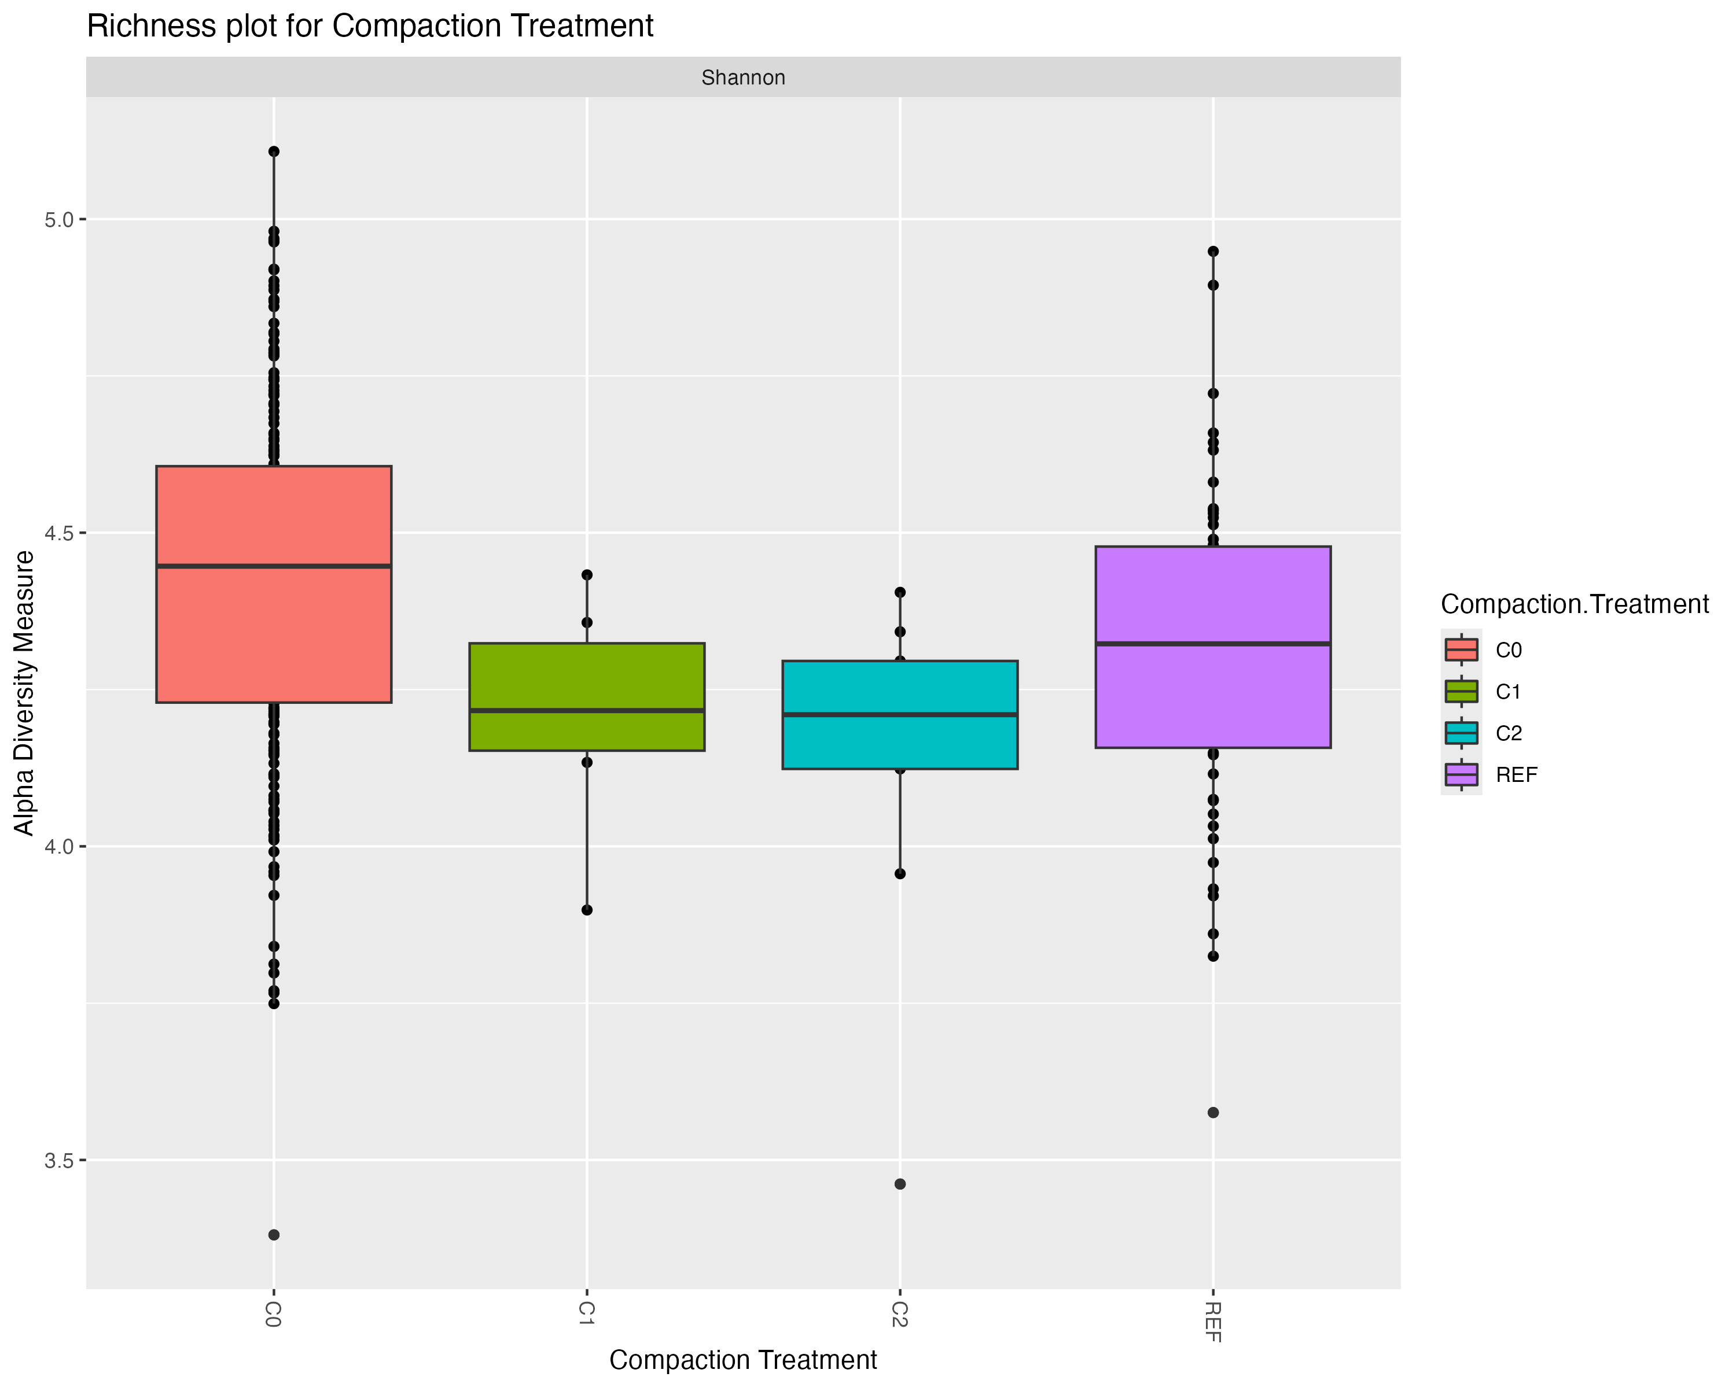
Figure 3: THIS BUT….. Separate by soil group and then put in 3 panels beside eachother
Alpha Diversity - Richness Compaction Treatment Not controlled for other variables

Slide 10
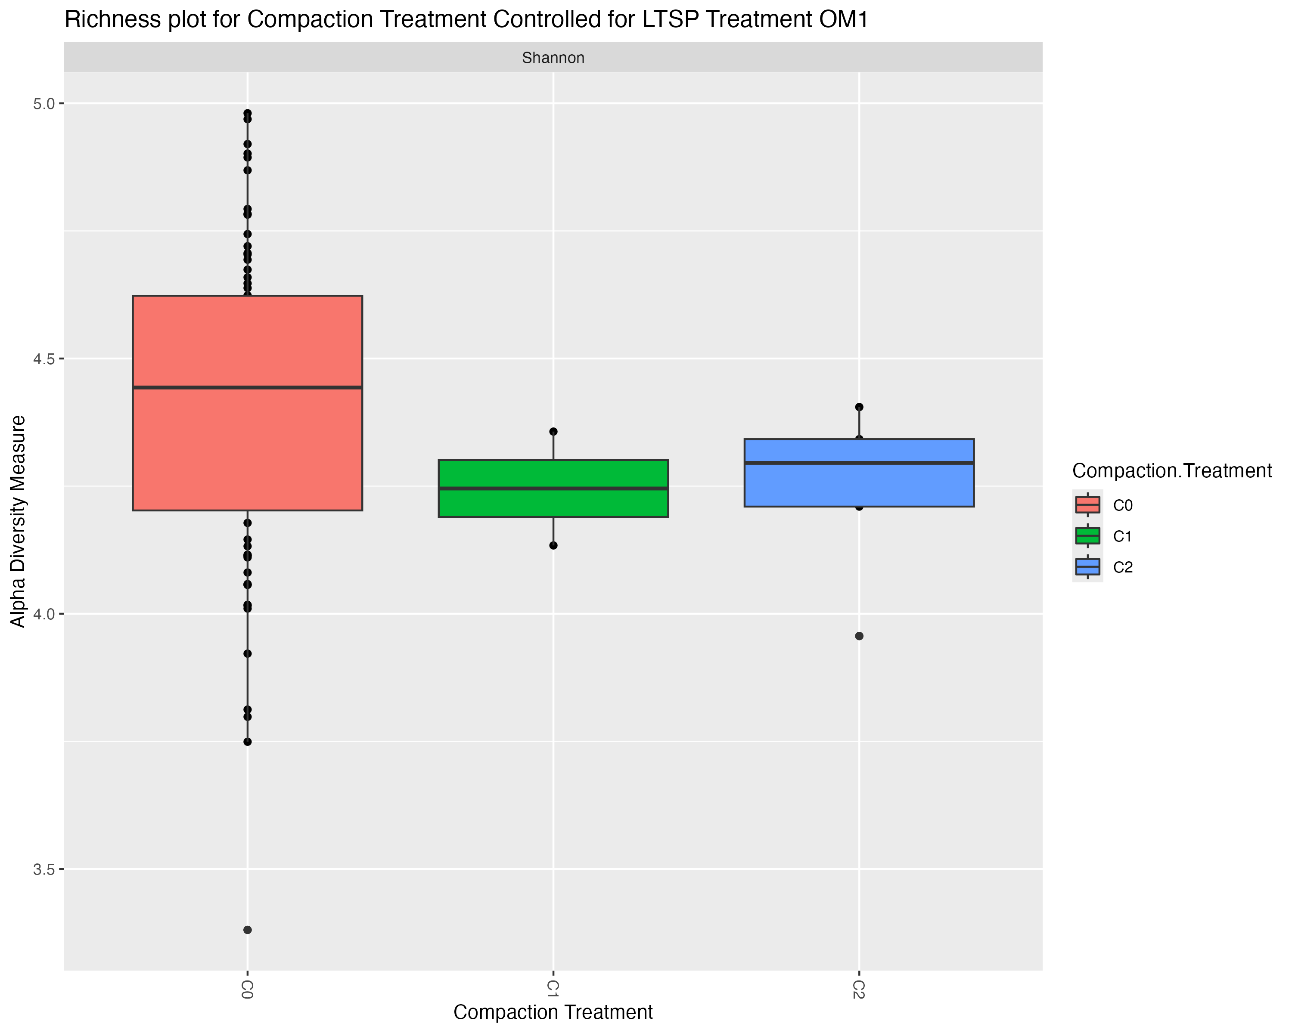
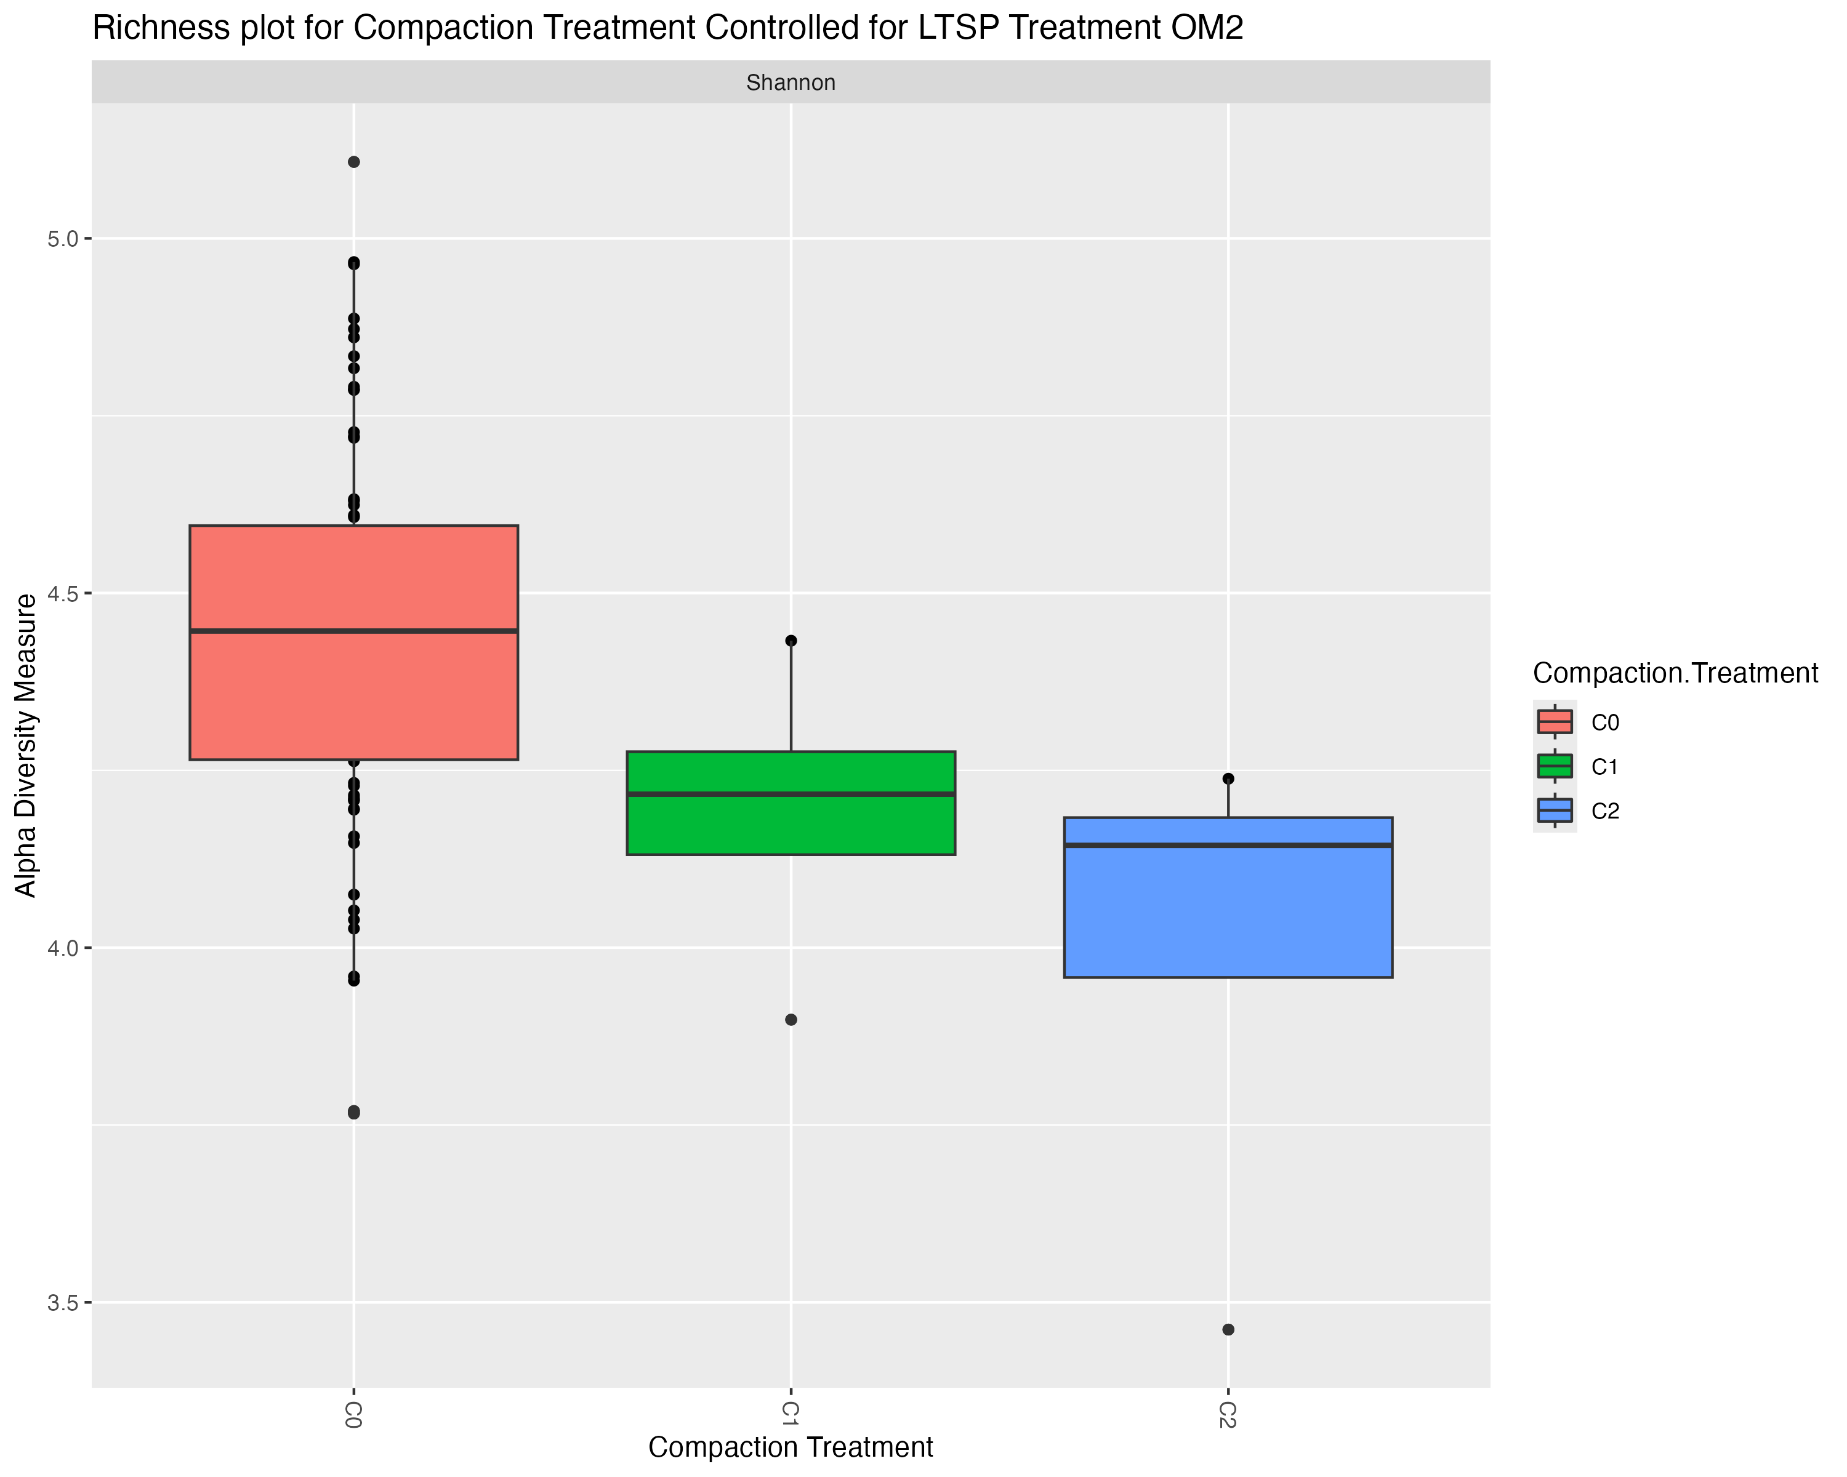
Alpha Diversity Richness – Controlled for LTSP Treatment
Figure 3

Slide 11
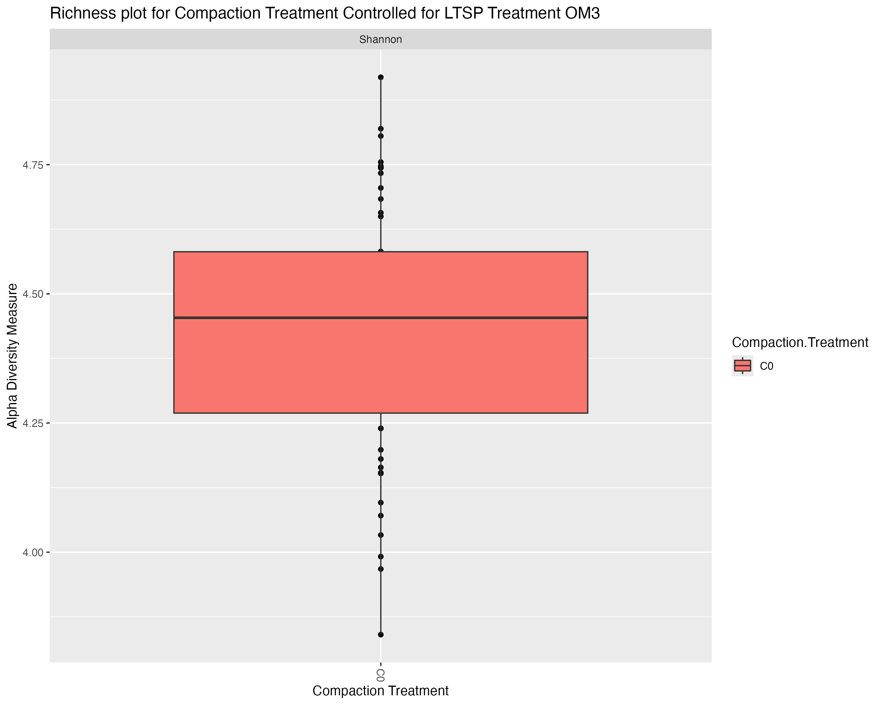
Alpha Diversity Richness – Controlled for LTSP Treatment
Talk about OM1 and OM2 how some more organic matter removal causes significant alpha diversity measure to be lower with C2 compaction treatment – may sure to check stats on this first

Slide 12
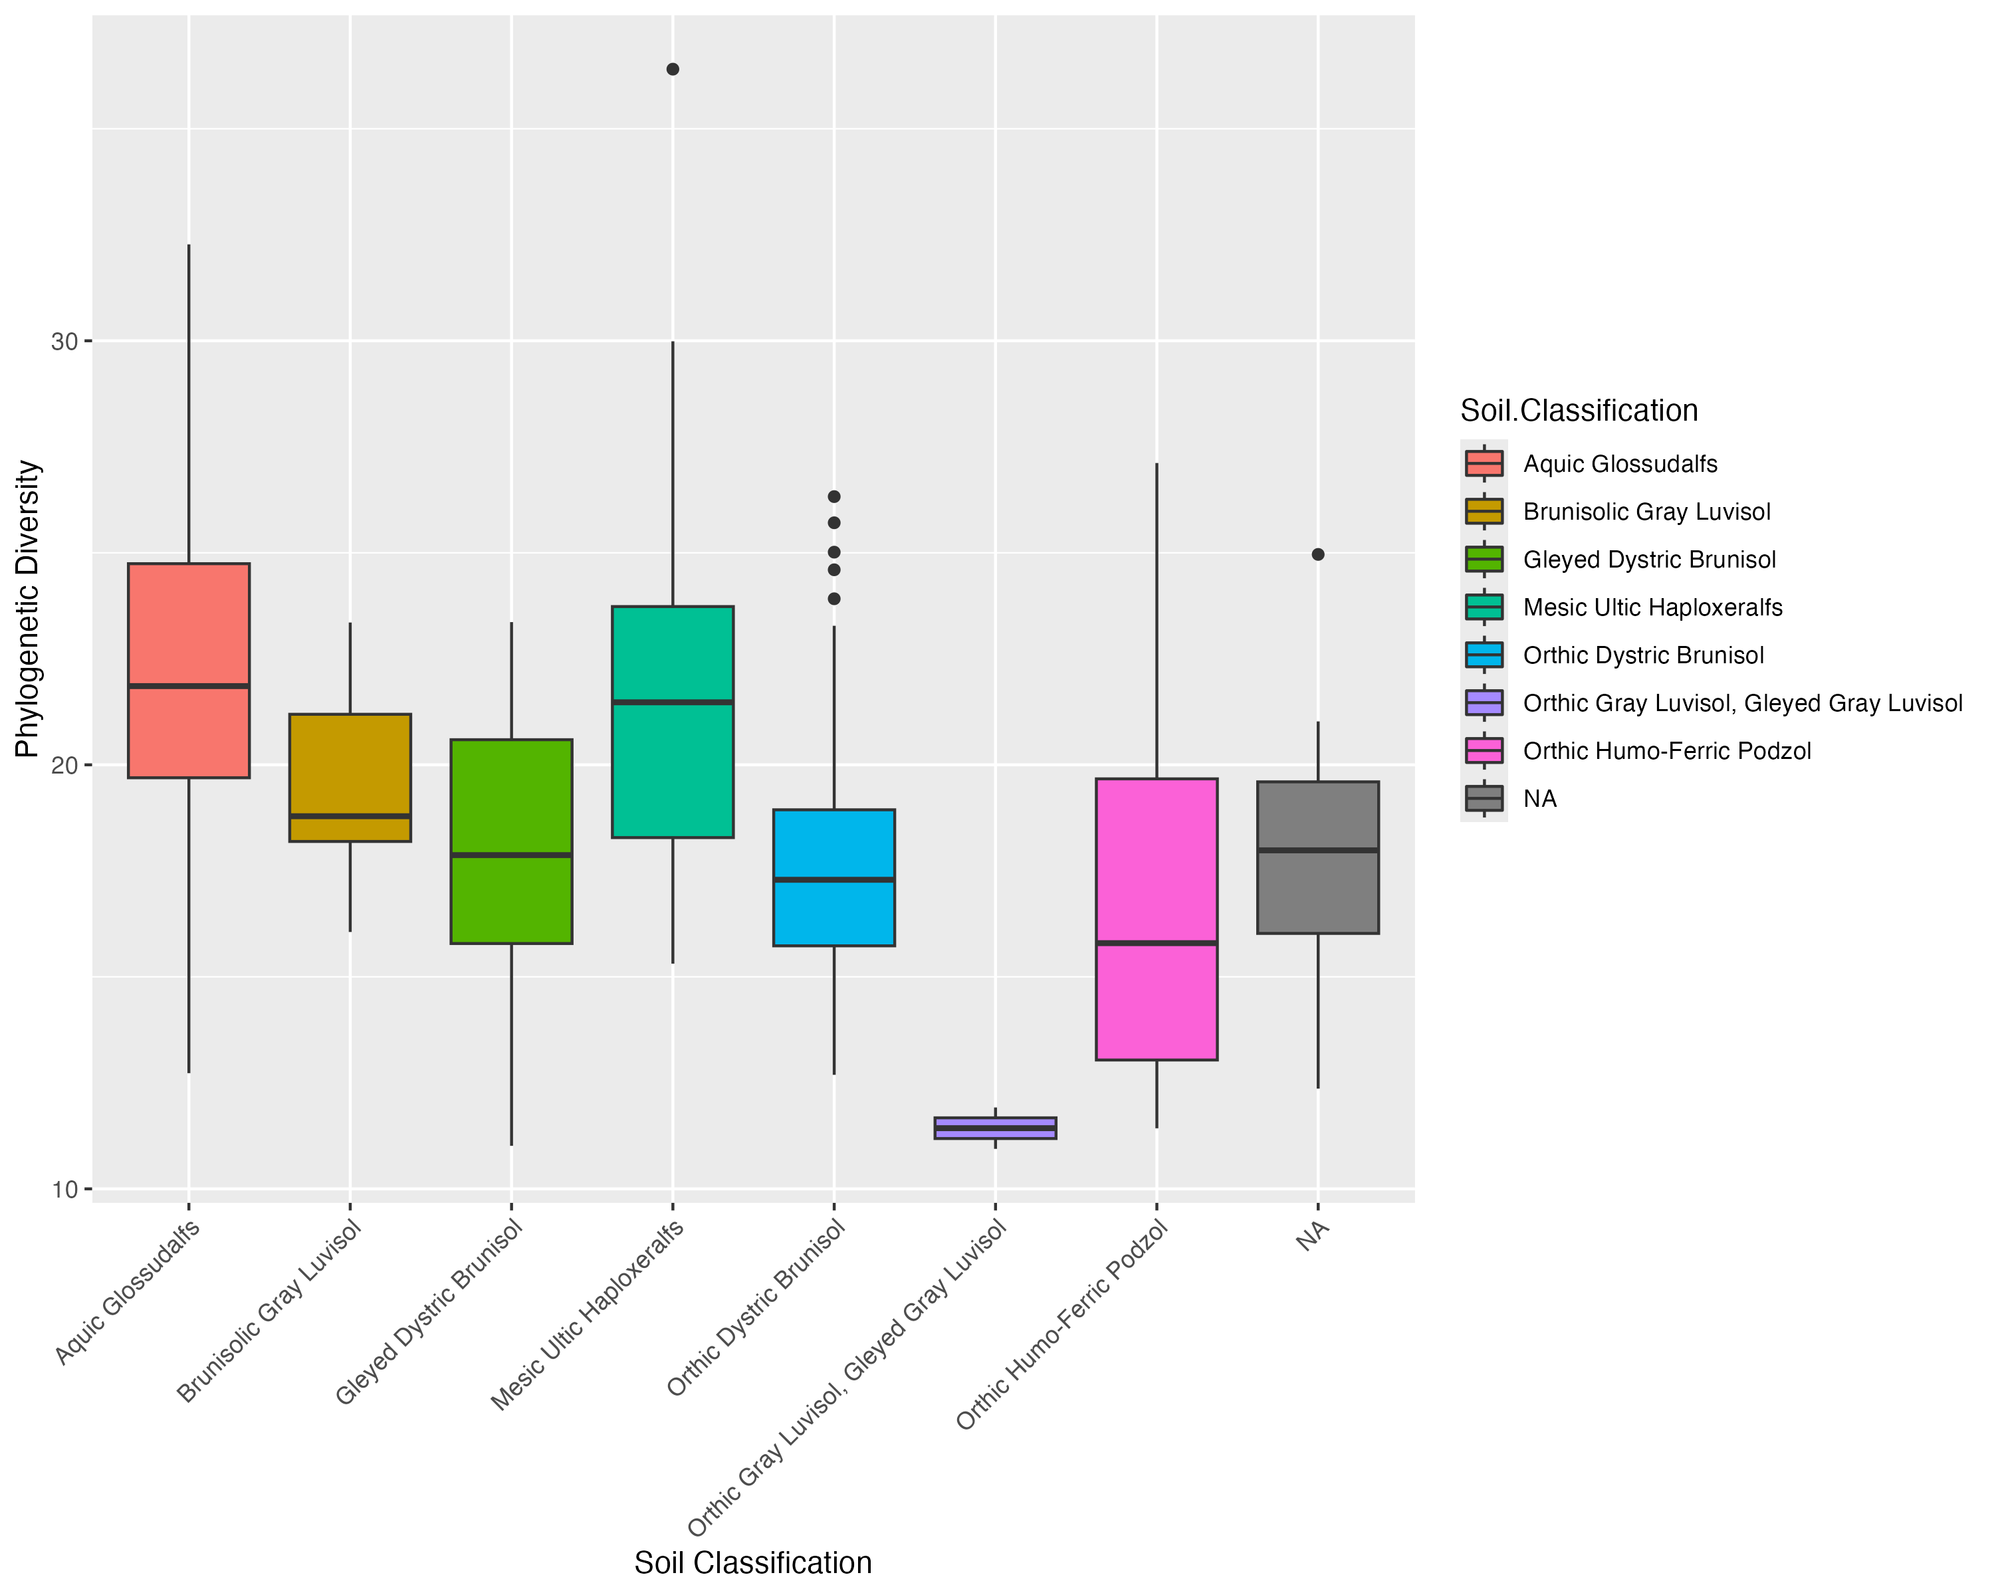
Phylogenetic Diversity – Soil Classification
Supplemental for figure 1, to show it is driven by both Shannon and faith
Notes:
Visually we can see that the box plots for soil type phylogenetic diversity have some variability in phylogenetic diversity, most notably the group "Orthic Gray Luvisol, Gleyed Gray Luvisol". However we need to do statistical analysis to see if this difference is significant.

Slide 13
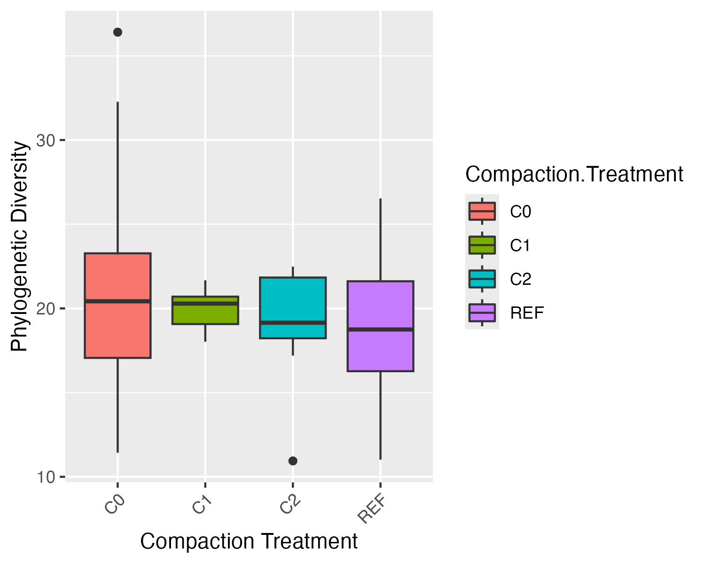
Phylogenetic Diversity – Compaction Level
Notes:
Visually we can see that the box plots for compaction treatment phylogenetic diversity have very little difference in their median values. However we need to do statistical analysis to check if there might be any significant difference.

Slide 14
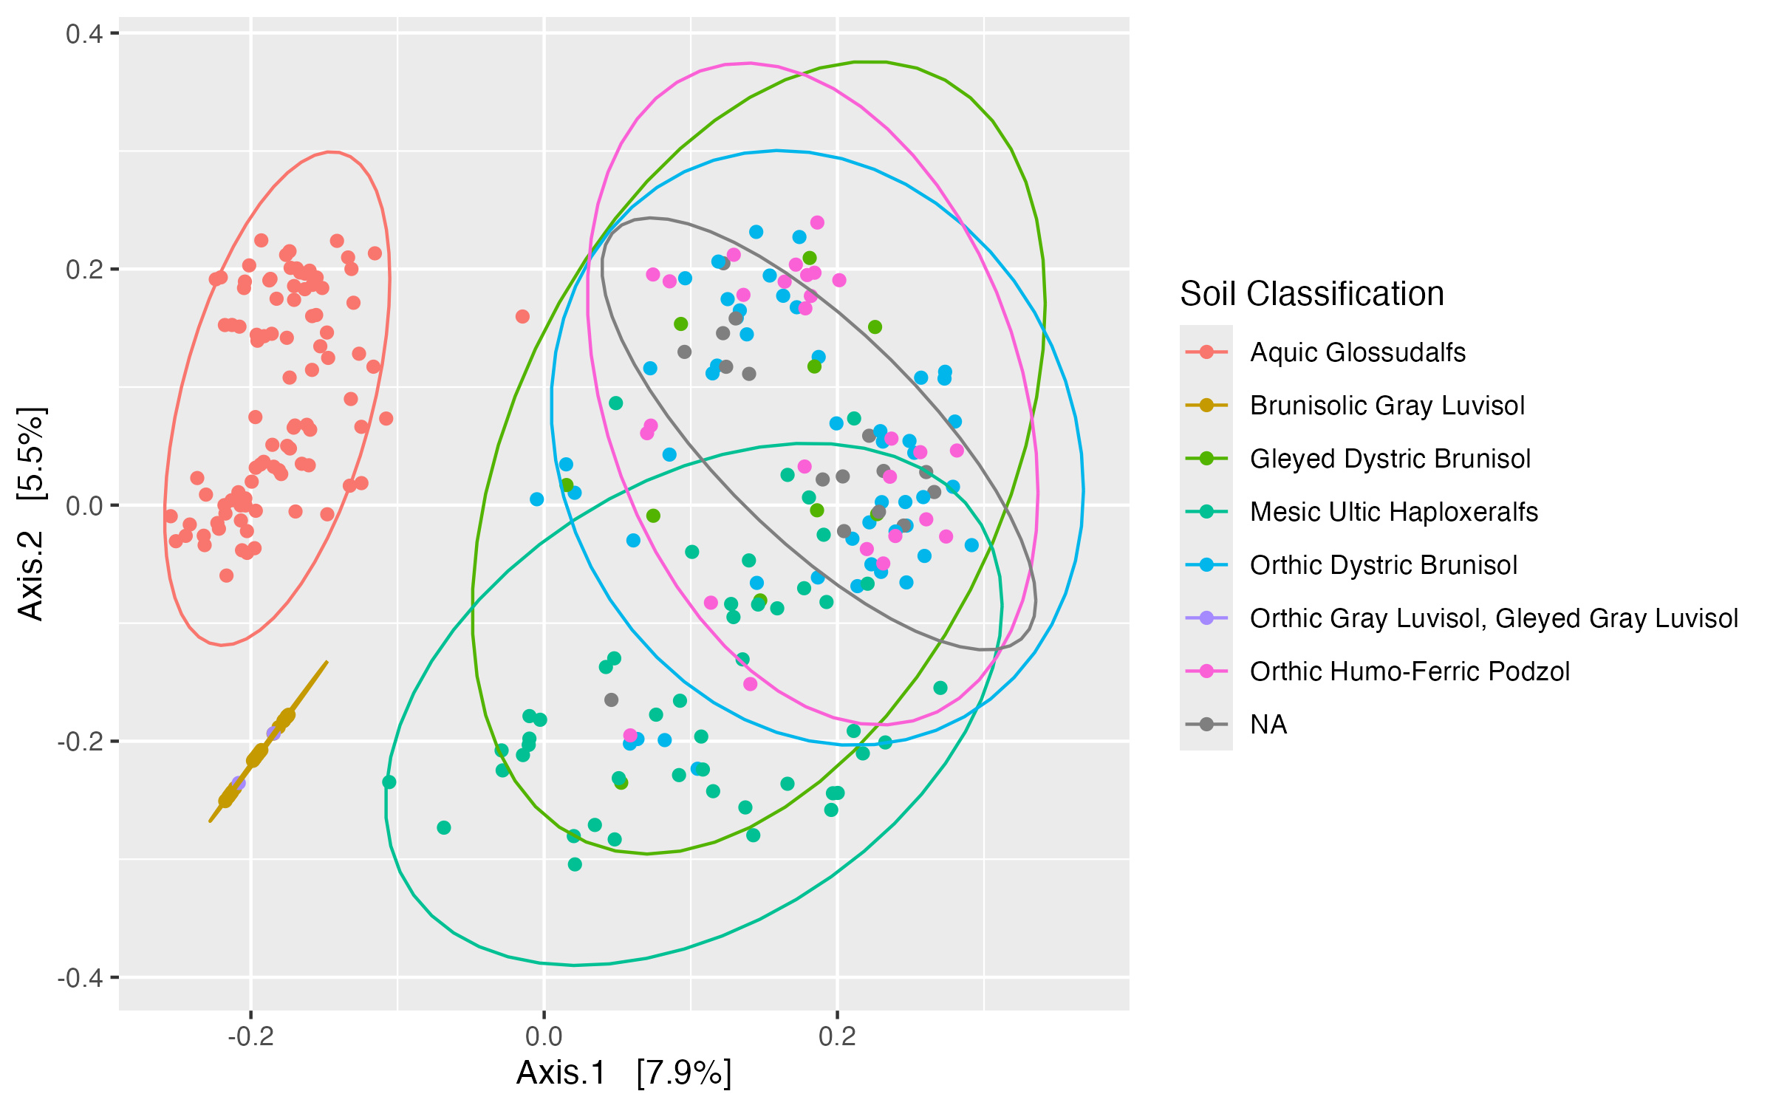
Beta Diversity Bray-Curtis PCOA Plot Soil Classification
Figure 2: annotate group 1, 2 and 3
Notes:
Bray-Curtis (Richness and Abundance/Evenness)
3 distinct groups:
Aquic Glossudalfs
Brunisolic Gray Luvisol, Orthis Gray Luvisol, Gleyed Gray Luvisol
The Rest
Soil Classification "Aquic Glossudalfs" has microbial communities that are different from the other groups.
"Brunisolic Gray Luvisol" and "Orthis Gray Luvisol, Gleyed Gray Luvisol" are very close to eachother and are both farther away than other groups
The rest of the soil types each have a specific cluster but overlap somewhat
It is worth to note that "NA" forms a tight cluster indicating that they may all be similar soil types (stats to be continued...

Slide 15
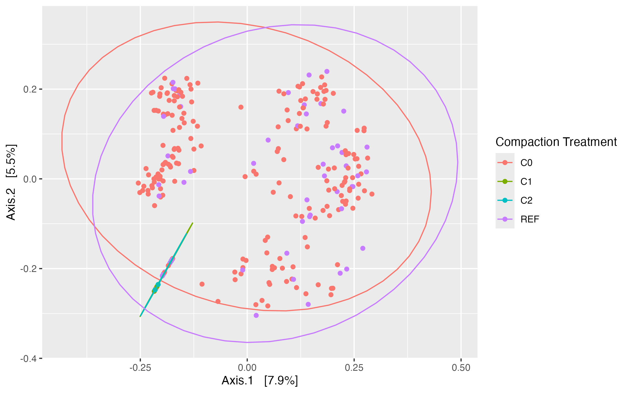
Beta Diversity Bray-Curtis PCOA Plot Compaction Level Next step: do a plot combining similar soil classifications
Notes:
compaction treatment C0 and REF are very similar and compaction treatments C1 and C2 are farther away in terms of beta diversity.
Important to note that there are a few red (C0) and purple (REF) points that are positioned close the C1 and C2.
There are also not that many data points for C1 and C2

Slide 16
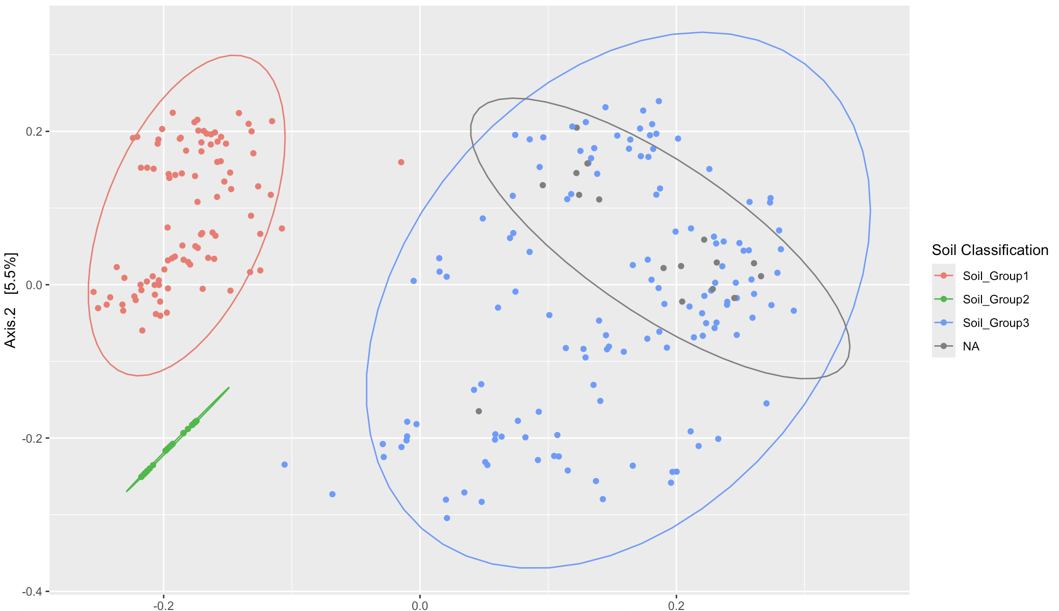
Get rid of NAs in all data

Slide 17
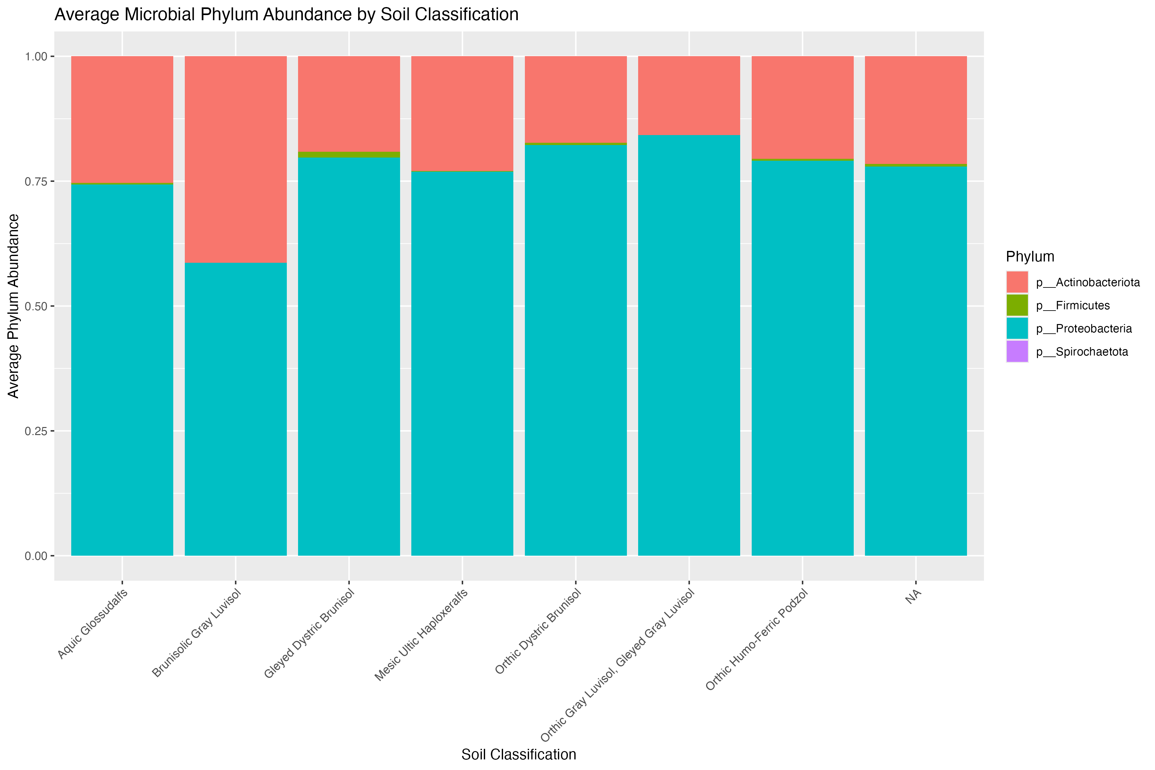
Taxa Bar Plot - Phylum Soil Classification

Slide 18
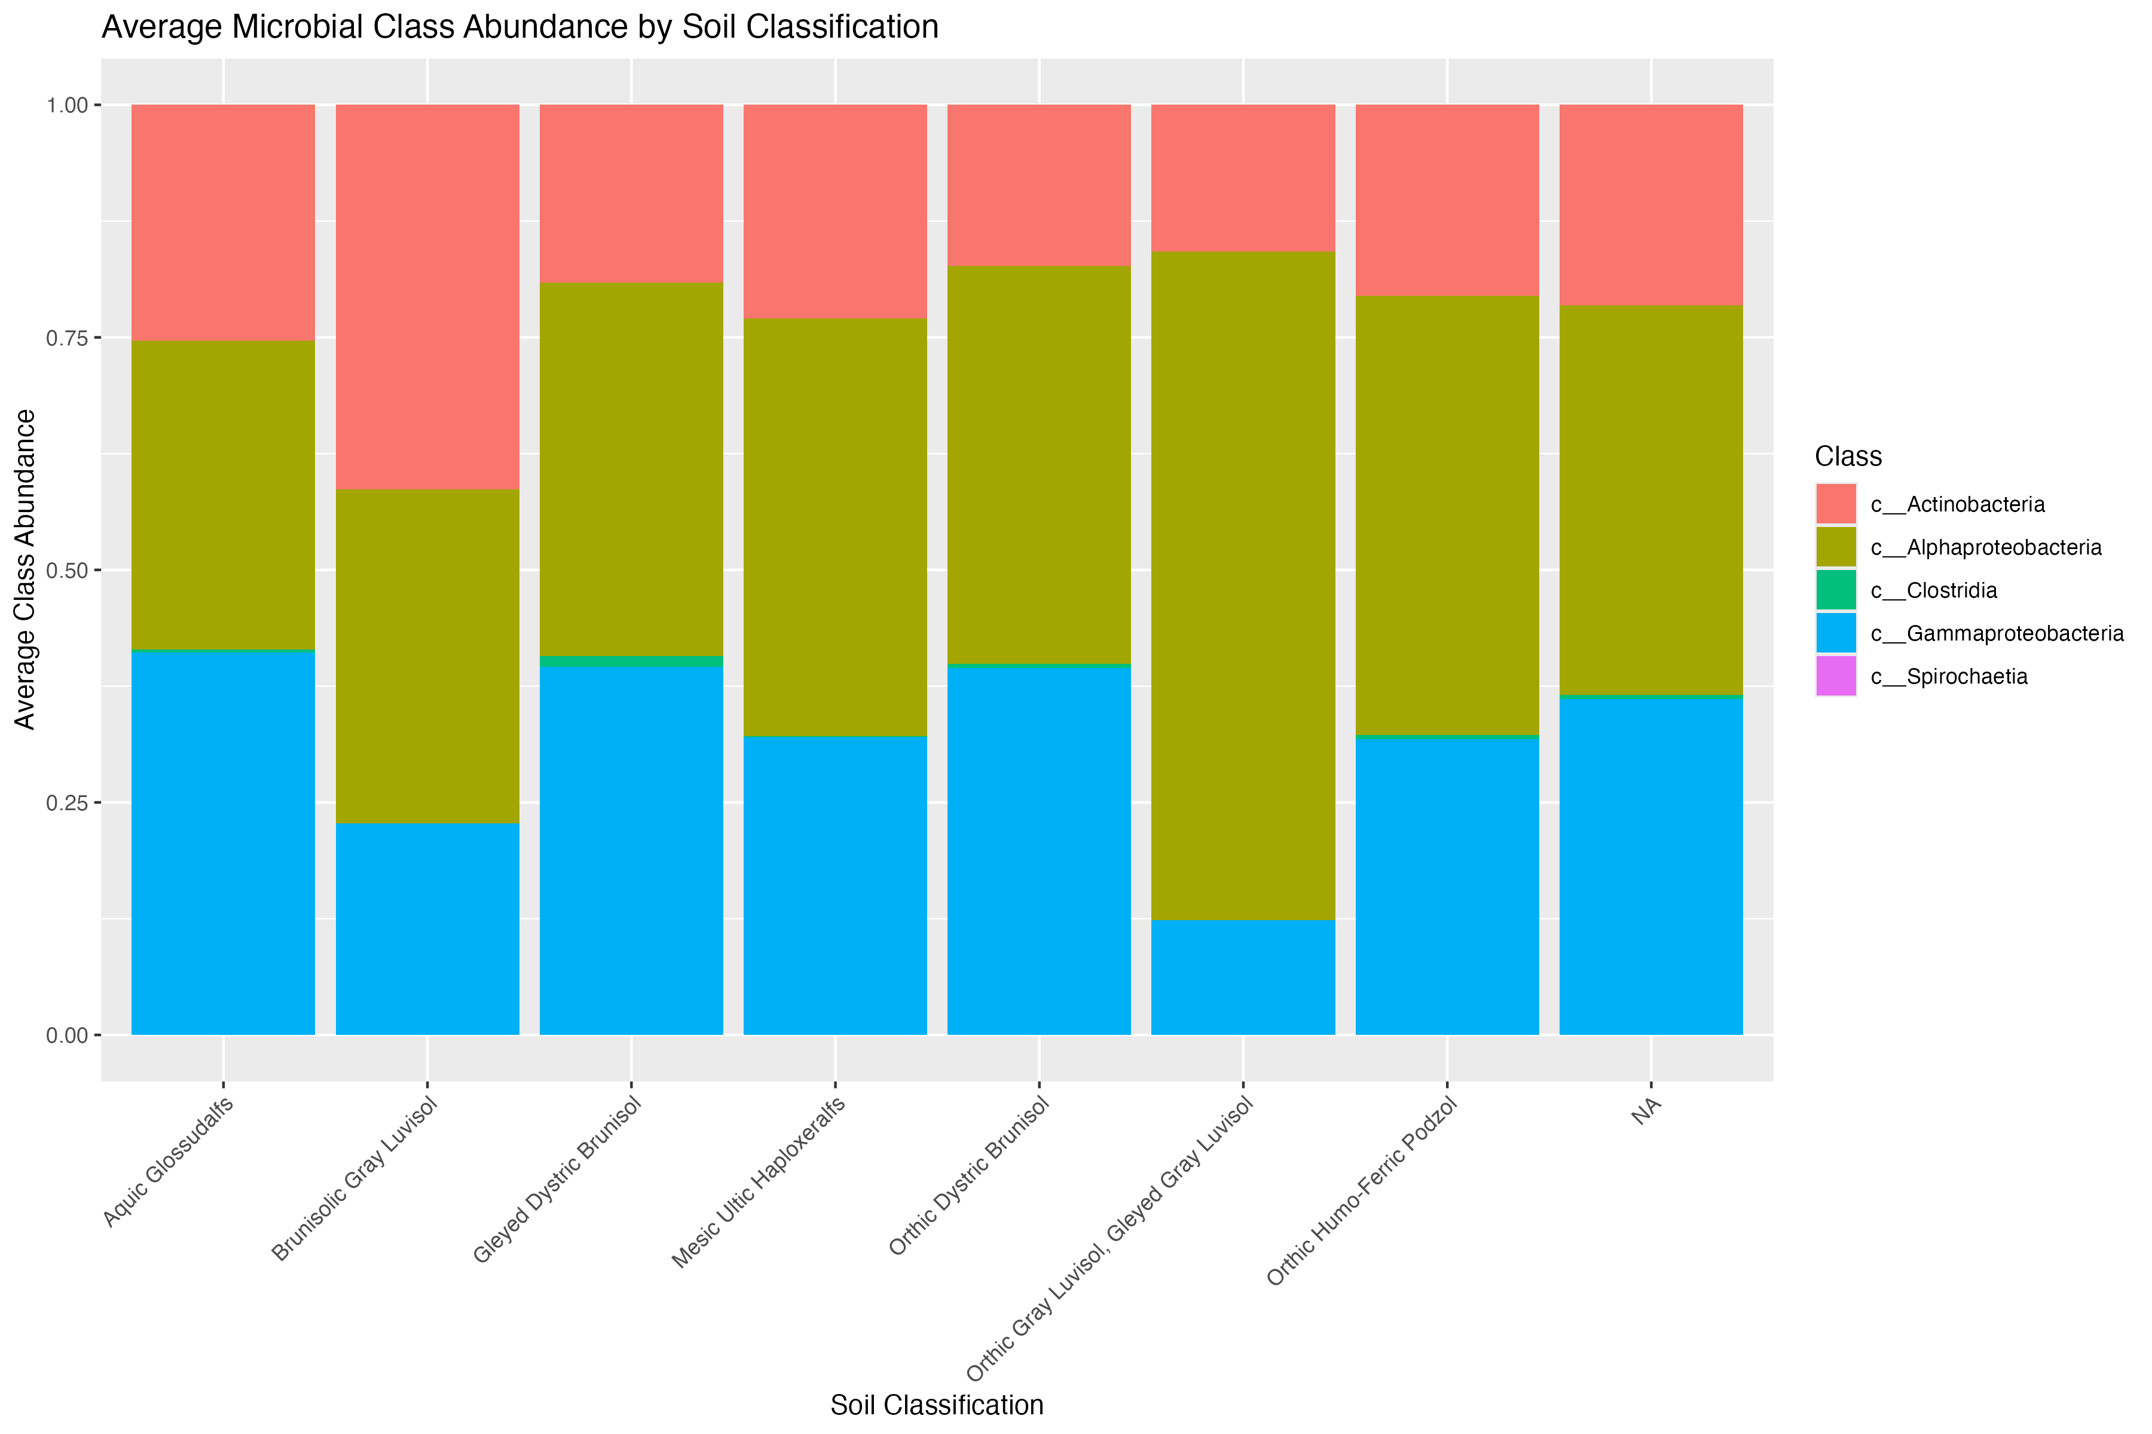
Taxa Bar Plot - Class Soil Classification

Slide 19
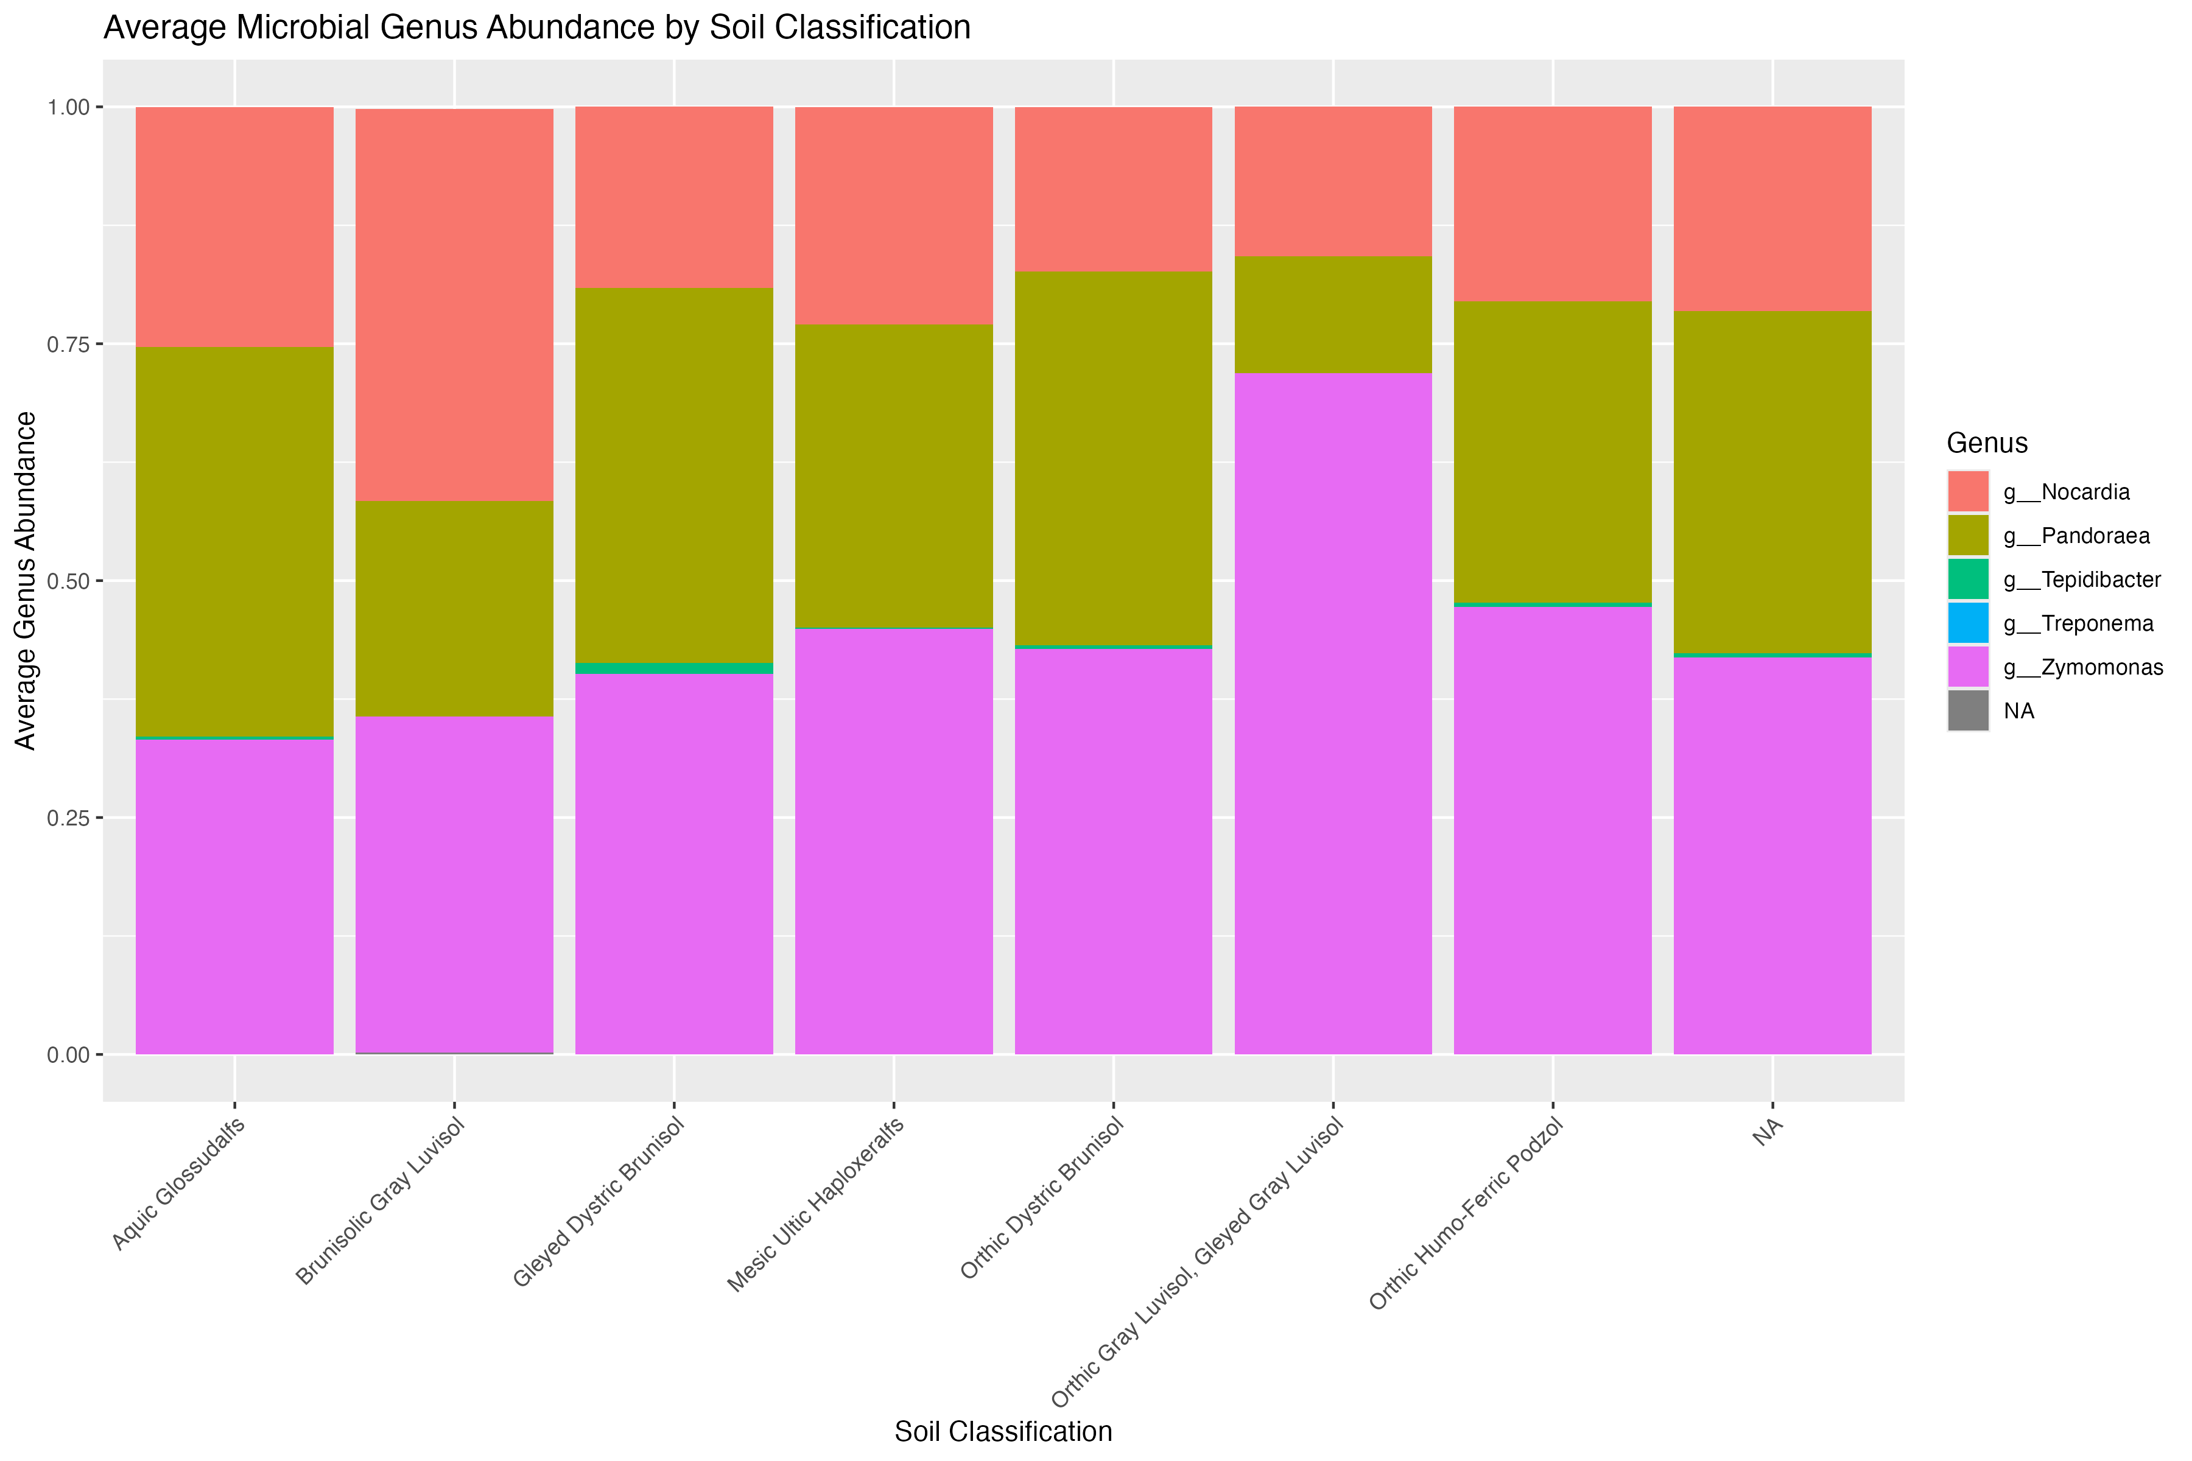
Taxa Bar Plot - Genus Soil Classification
Supplemental plots 2: 1 soil type 1 compaction for figure 2
Talk about how this group has more of the purple genus so it is a lot less even than the other soil types leading to lower alpha diversity because it is all mostly one group

Slide 20
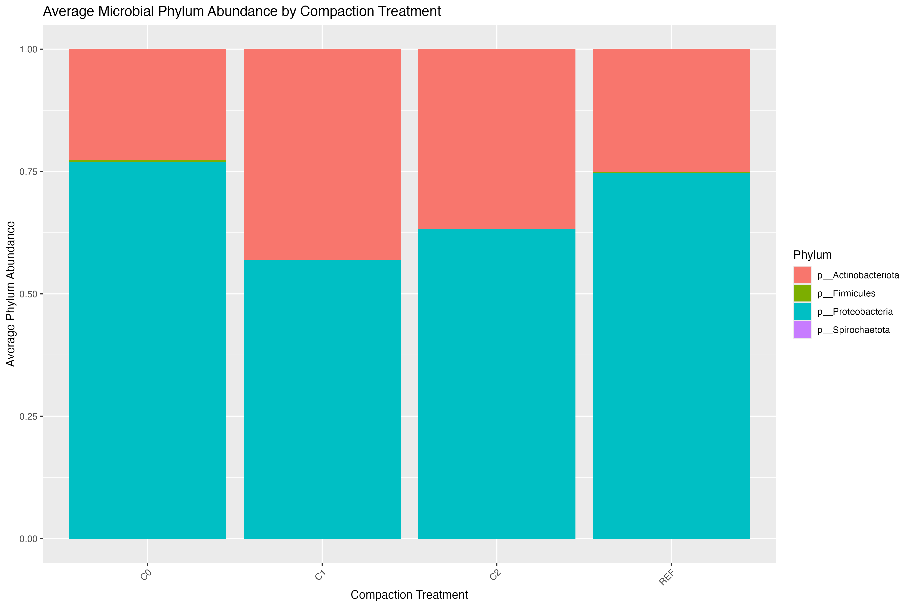
Taxa Bar Plot - Phylum Compaction Treatment

Slide 21
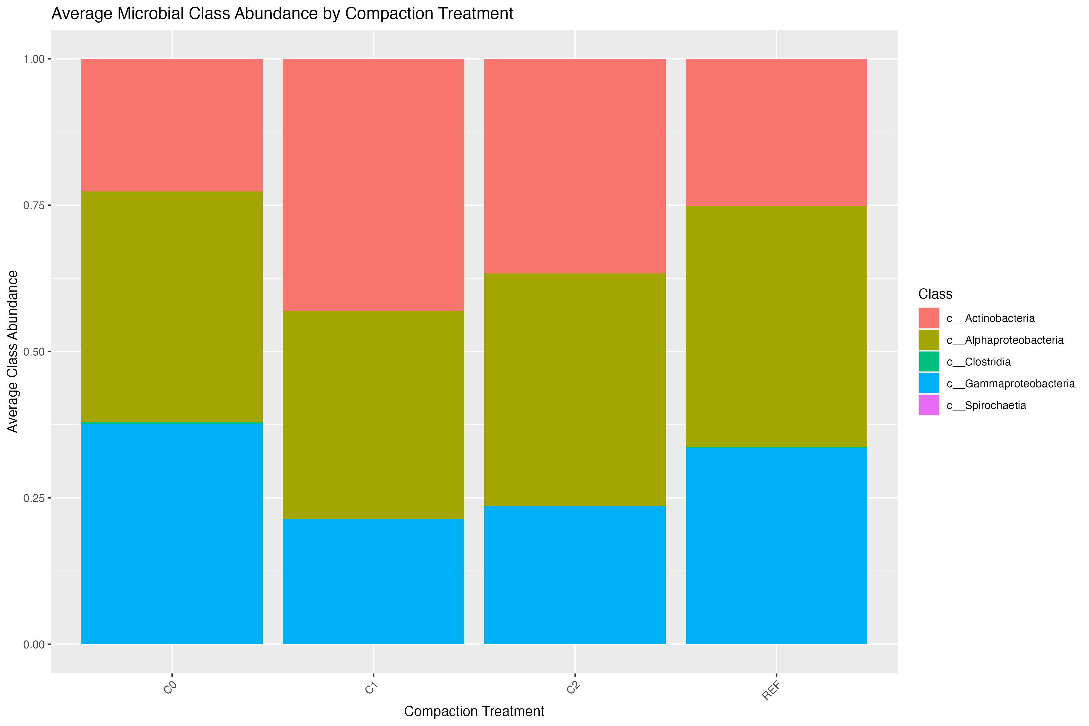
Taxa Bar Plot - Class Compaction Treatment

Slide 22
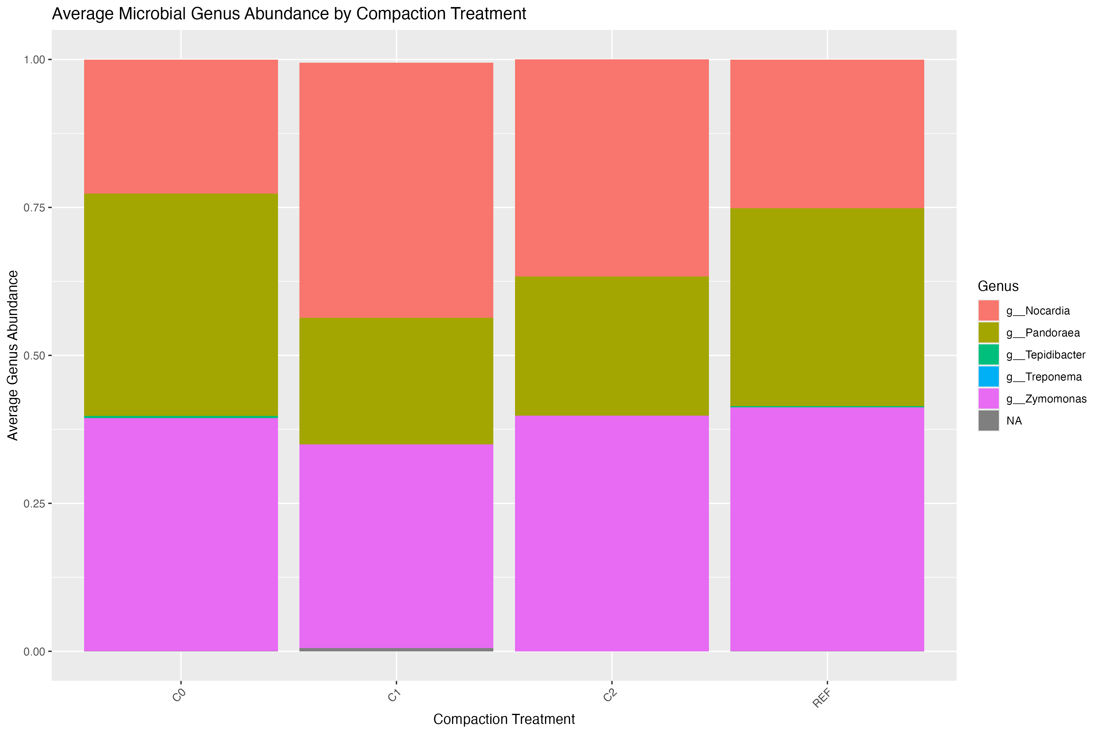
Taxa Bar Plot - Genus Compaction Treatment

Slide 23
Core Microbiome Analysis
What are the core microbiomes and how do they differ across soil classifications?
Method:
The set of microbial taxa that are associated with a treatment, host, or environmental condition
Venn Diagram
Use relative abundance
Determine shared and unique ASVs (or taxa)

Slide 24
Indicator Taxa/Species Analysis
What species can be used to predict soil type?
Method:
Non-parametric test represented as a table: gives each ASV a score based on relative abundance and prevalence
100*RelativeAbundance*RelativeFrequency
Will take this high indicator value, randomize different groups and creates a normal distribute based on random sampling
Compares “real” Indicator value to see if it falls within 90% of the normal distribution

Slide 25
Indicator Species – Soil Classification
ASV | s.Aquic Glossudalfs | s.Brunisolic Gray Luvisol | s.Gleyed Dystric Brunisol | s.Mesic Ultic Haploxeralfs | s.Orthic Dystric Brunisol | s.Orthic Gray Luvisol | s.Orthic Gray Luvisol, Gleyed Gray Luvisol | s.Orthic Humo-Ferric Podzol | s.Orthic Humo-Ferric Podzol, Gleyed Eluviated Dystric Brunisol | index | stat | p.value | Domain | Phylum | Class | Order | Family | Genus | Species
36137ddd50c27ae8649f75aea140aab6 | 0 | 0 | 1 | 0 | 1 | 0 | 0 | 1 | 0 | 102 | 65% | 0.005 | d__Bacteria | p__Firmicutes | c__Clostridia | o__Peptostreptococcales-Tissierellales | f__Peptostreptococcaceae | g__Tepidibacter | s__uncultured_Gram-positive
f5533cbb7c69904141b1bf45fe8a78ce | 0 | 0 | 0 | 0 | 0 | 0 | 0 | 0 | 1 | 9 | 20% | 0.02 | d__Bacteria | p__Actinobacteriota | c__Actinobacteria | o__Corynebacteriales | f__Nocardiaceae | NA | NA
168e1b577c8a255d7fa70309735faf9c | 0 | 1 | 0 | 0 | 0 | 1 | 0 | 0 | 1 | 91 | 36% | 0.005 | d__Bacteria | p__Proteobacteria | c__Alphaproteobacteria | o__Sphingomonadales | f__Sphingomonadaceae | NA | NA
These are not significant! It is below 70-75% makes sense because soil is usually homogenous anyways.
Also, this table is not the best way to show this, better to just show stat and the phylogenetic words

Slide 26
Indicator Species – Compaction Level
ASV | s.C0 | s.C1 | s.C2 | s.REF | index | stat | p.value | Domain | Phylum | Class | Order | Family | Genus | Species
36137ddd50c27ae8649f75aea140aab6 | 1 | 0 | 0 | 1 | 7 | 55% | 0.005 | d__Bacteria | p__Firmicutes | c__Clostridia | o__Peptostreptococcales-Tissierellales | f__Peptostreptococcaceae | g__Tepidibacter | s__uncultured_Gram-positive
168e1b577c8a255d7fa70309735faf9c | 0 | 1 | 1 | 0 | 8 | 35% | 0.005 | d__Bacteria | p__Proteobacteria | c__Alphaproteobacteria | o__Sphingomonadales | f__Sphingomonadaceae | NA | NA

Slide 27
ASV | s.Aquic Glossudalfs | s.Brunisolic Gray Luvisol | s.Gleyed Dystric Brunisol | s.Mesic Ultic Haploxeralfs | s.Orthic Dystric Brunisol | s.Orthic Gray Luvisol | s.Orthic Gray Luvisol, Gleyed Gray Luvisol | s.Orthic Humo-Ferric Podzol | s.Orthic Humo-Ferric Podzol, Gleyed Eluviated Dystric Brunisol | index | stat | p.value | Domain | Phylum | Class | Order | Family | Genus | Species
36137ddd50c27ae8649f75aea140aab6 | 0 | 0 | 1 | 0 | 1 | 0 | 0 | 1 | 0 | 102 | 65% | 0.005 | d__Bacteria | p__Firmicutes | c__Clostridia | o__Peptostreptococcales-Tissierellales | f__Peptostreptococcaceae | g__Tepidibacter | s__uncultured_Gram-positive
f5533cbb7c69904141b1bf45fe8a78ce | 0 | 0 | 0 | 0 | 0 | 0 | 0 | 0 | 1 | 9 | 20% | 0.02 | d__Bacteria | p__Actinobacteriota | c__Actinobacteria | o__Corynebacteriales | f__Nocardiaceae | NA | NA
168e1b577c8a255d7fa70309735faf9c | 0 | 1 | 0 | 0 | 0 | 1 | 0 | 0 | 1 | 91 | 36% | 0.005 | d__Bacteria | p__Proteobacteria | c__Alphaproteobacteria | o__Sphingomonadales | f__Sphingomonadaceae | NA | NA
ASV | s.C0 | s.C1 | s.C2 | s.REF | index | stat | p.value | Domain | Phylum | Class | Order | Family | Genus | Species
36137ddd50c27ae8649f75aea140aab6 | 1 | 0 | 0 | 1 | 7 | 55% | 0.005 | d__Bacteria | p__Firmicutes | c__Clostridia | o__Peptostreptococcales-Tissierellales | f__Peptostreptococcaceae | g__Tepidibacter | s__uncultured_Gram-positive
168e1b577c8a255d7fa70309735faf9c | 0 | 1 | 1 | 0 | 8 | 35% | 0.005 | d__Bacteria | p__Proteobacteria | c__Alphaproteobacteria | o__Sphingomonadales | f__Sphingomonadaceae | NA | NA

Slide 28
Differential Abundance
How does compactness level impact abundance within the soil microbial community?
Method:
Determine ASVs that have decreased or increased in presence relative to a reference
Parametric test that follows a negative binomial distribution

Slide 29
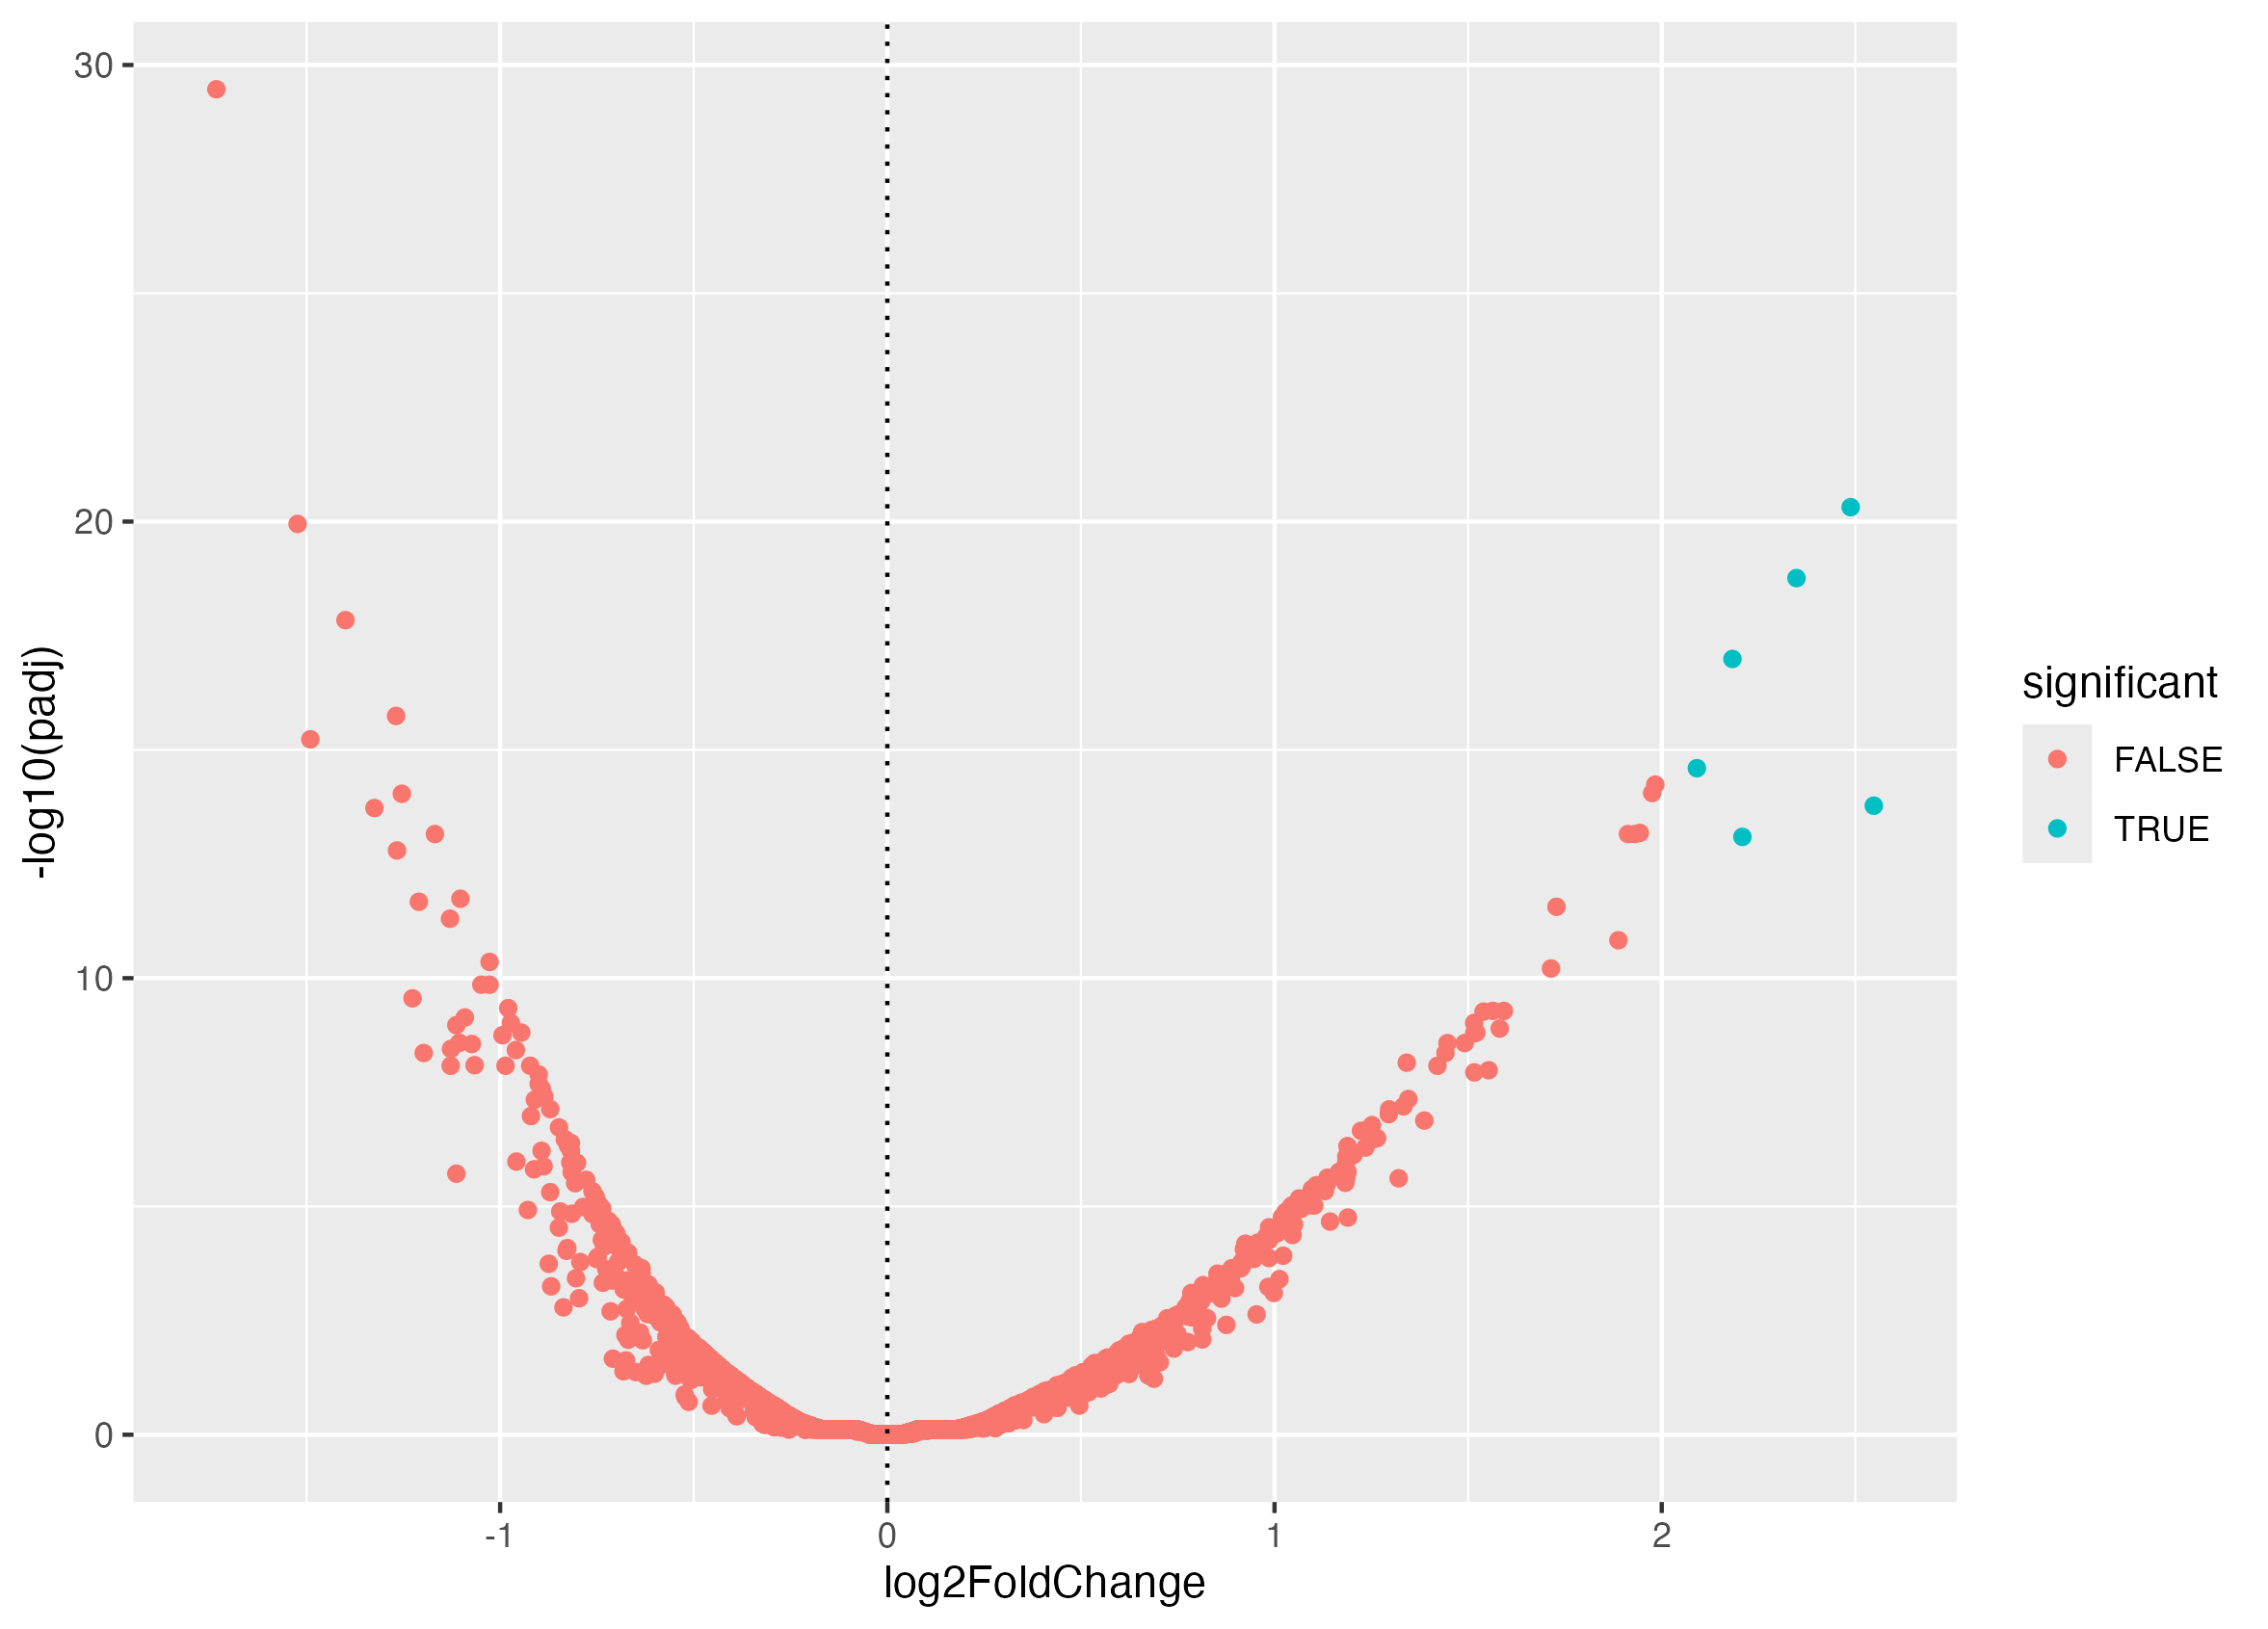
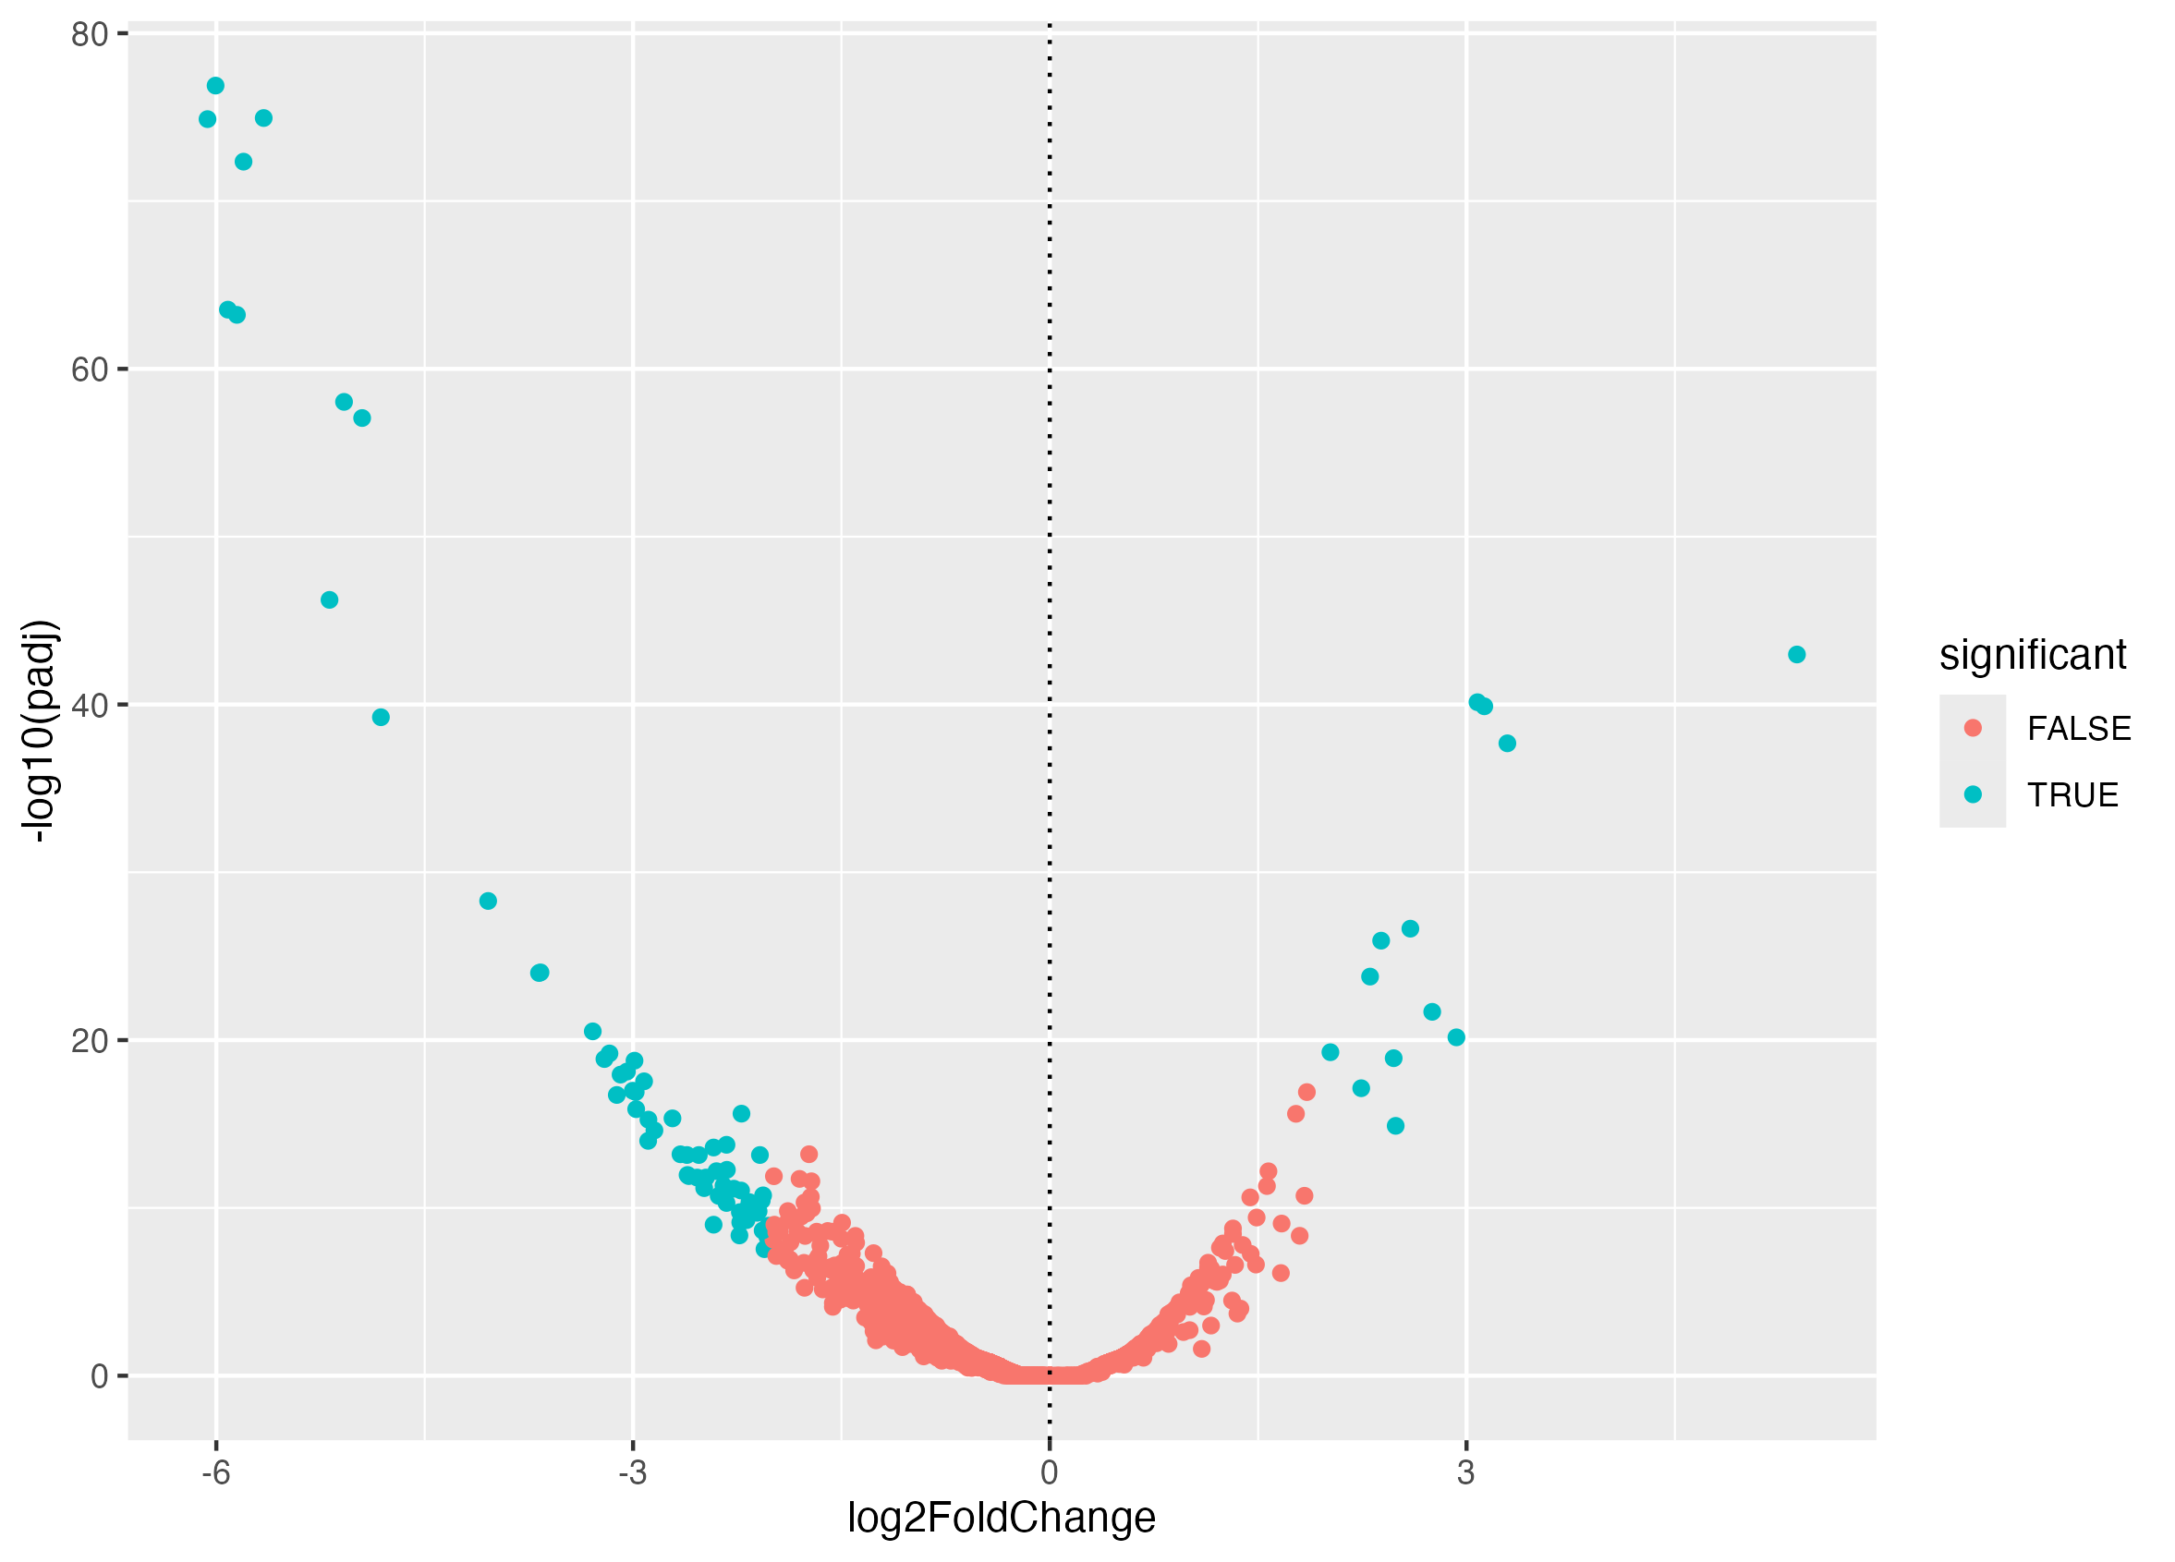
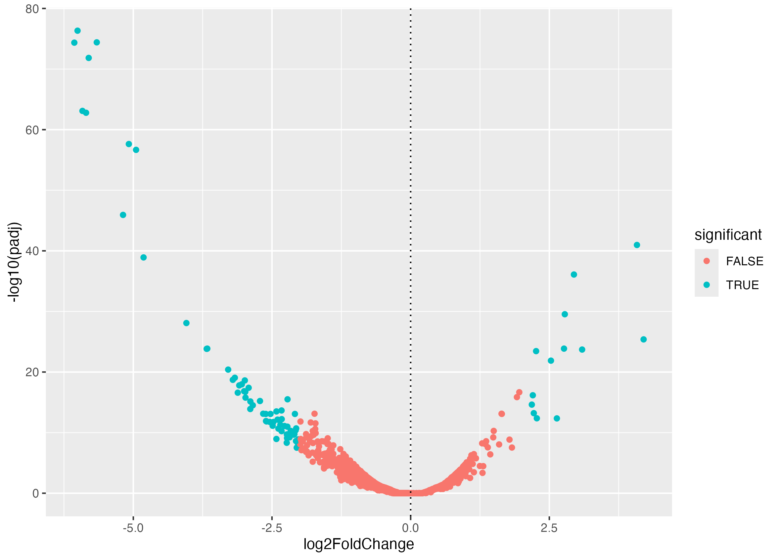
C0
Conclusion: Some ASVs have significantly decreased and a few significantly increased
Blue = significant
All compared to reference
Shown as volcano plots: On the left is decrease in abundance and right is increase in abundance
Figure 4: for compaction
It is better to show these plots side by side horizontally
C1
C2
Notes:
Figures 1-3 Red is non-significant, blue is significant. All are compared to reference. On the left is decrease in abundance and right is increase in abundance with the dotted line showing 0. Plot 0 = C0. plot 1 = C1, plot 2 = C2.

Slide 30
Correlation Analysis
What environmental factor(s) are most associated with each soil classification?
Method: Contingency table (frequencies) is created and visualized as a heatmap

Slide 31
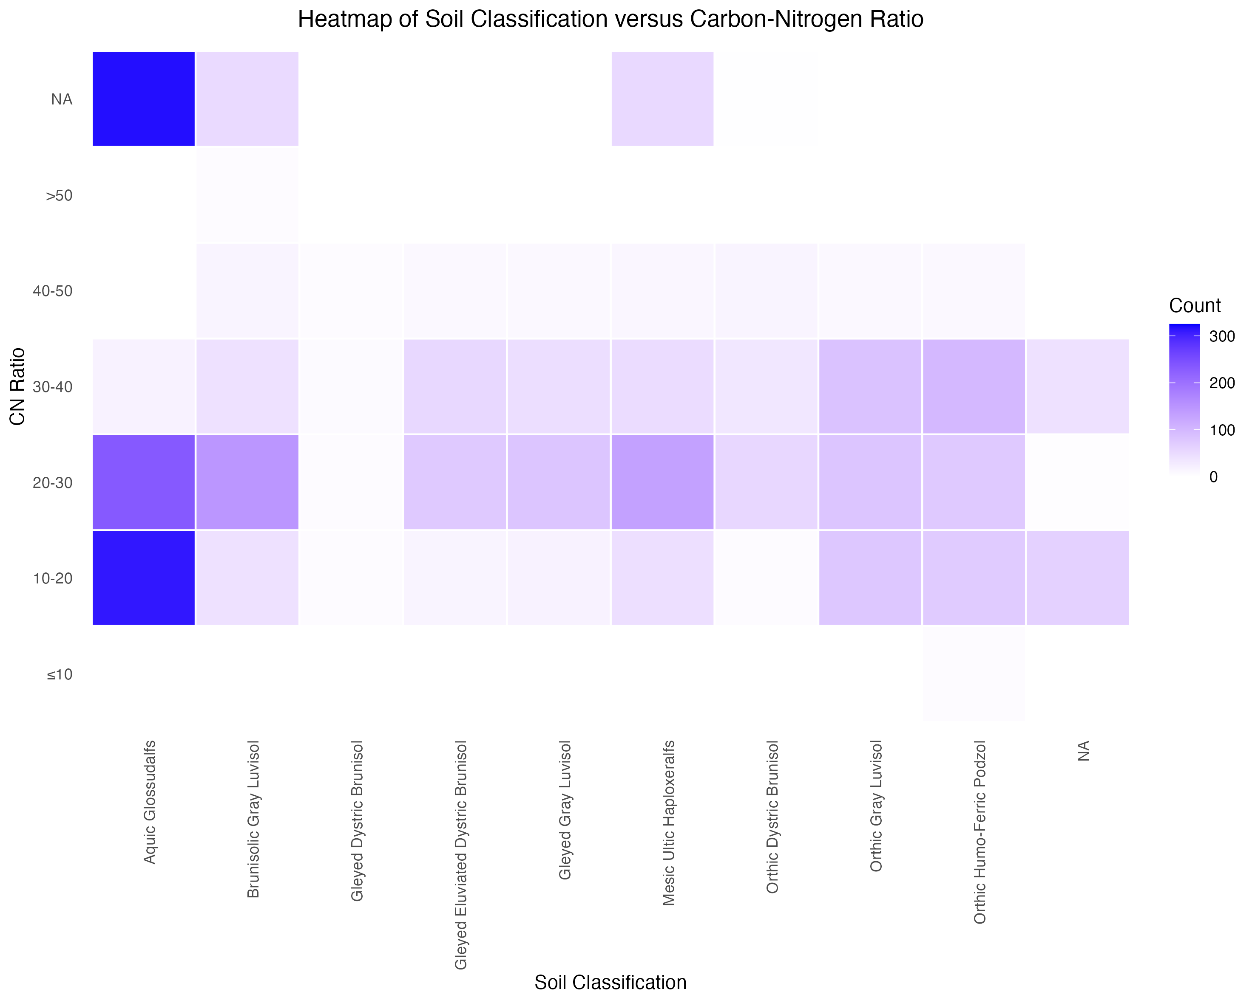
Notes:
Figure 1. Heat Map of Soil Classification and CN Ratio. Aquic Glossudualfs appears to correlate most with a CN Ratio of 10-20, while Orthic Humo-Ferric Podzal correlates most with a CN ratio of 30-40. The remaining soil classifications correlate most with a CN ratio of 20-30.

Slide 32
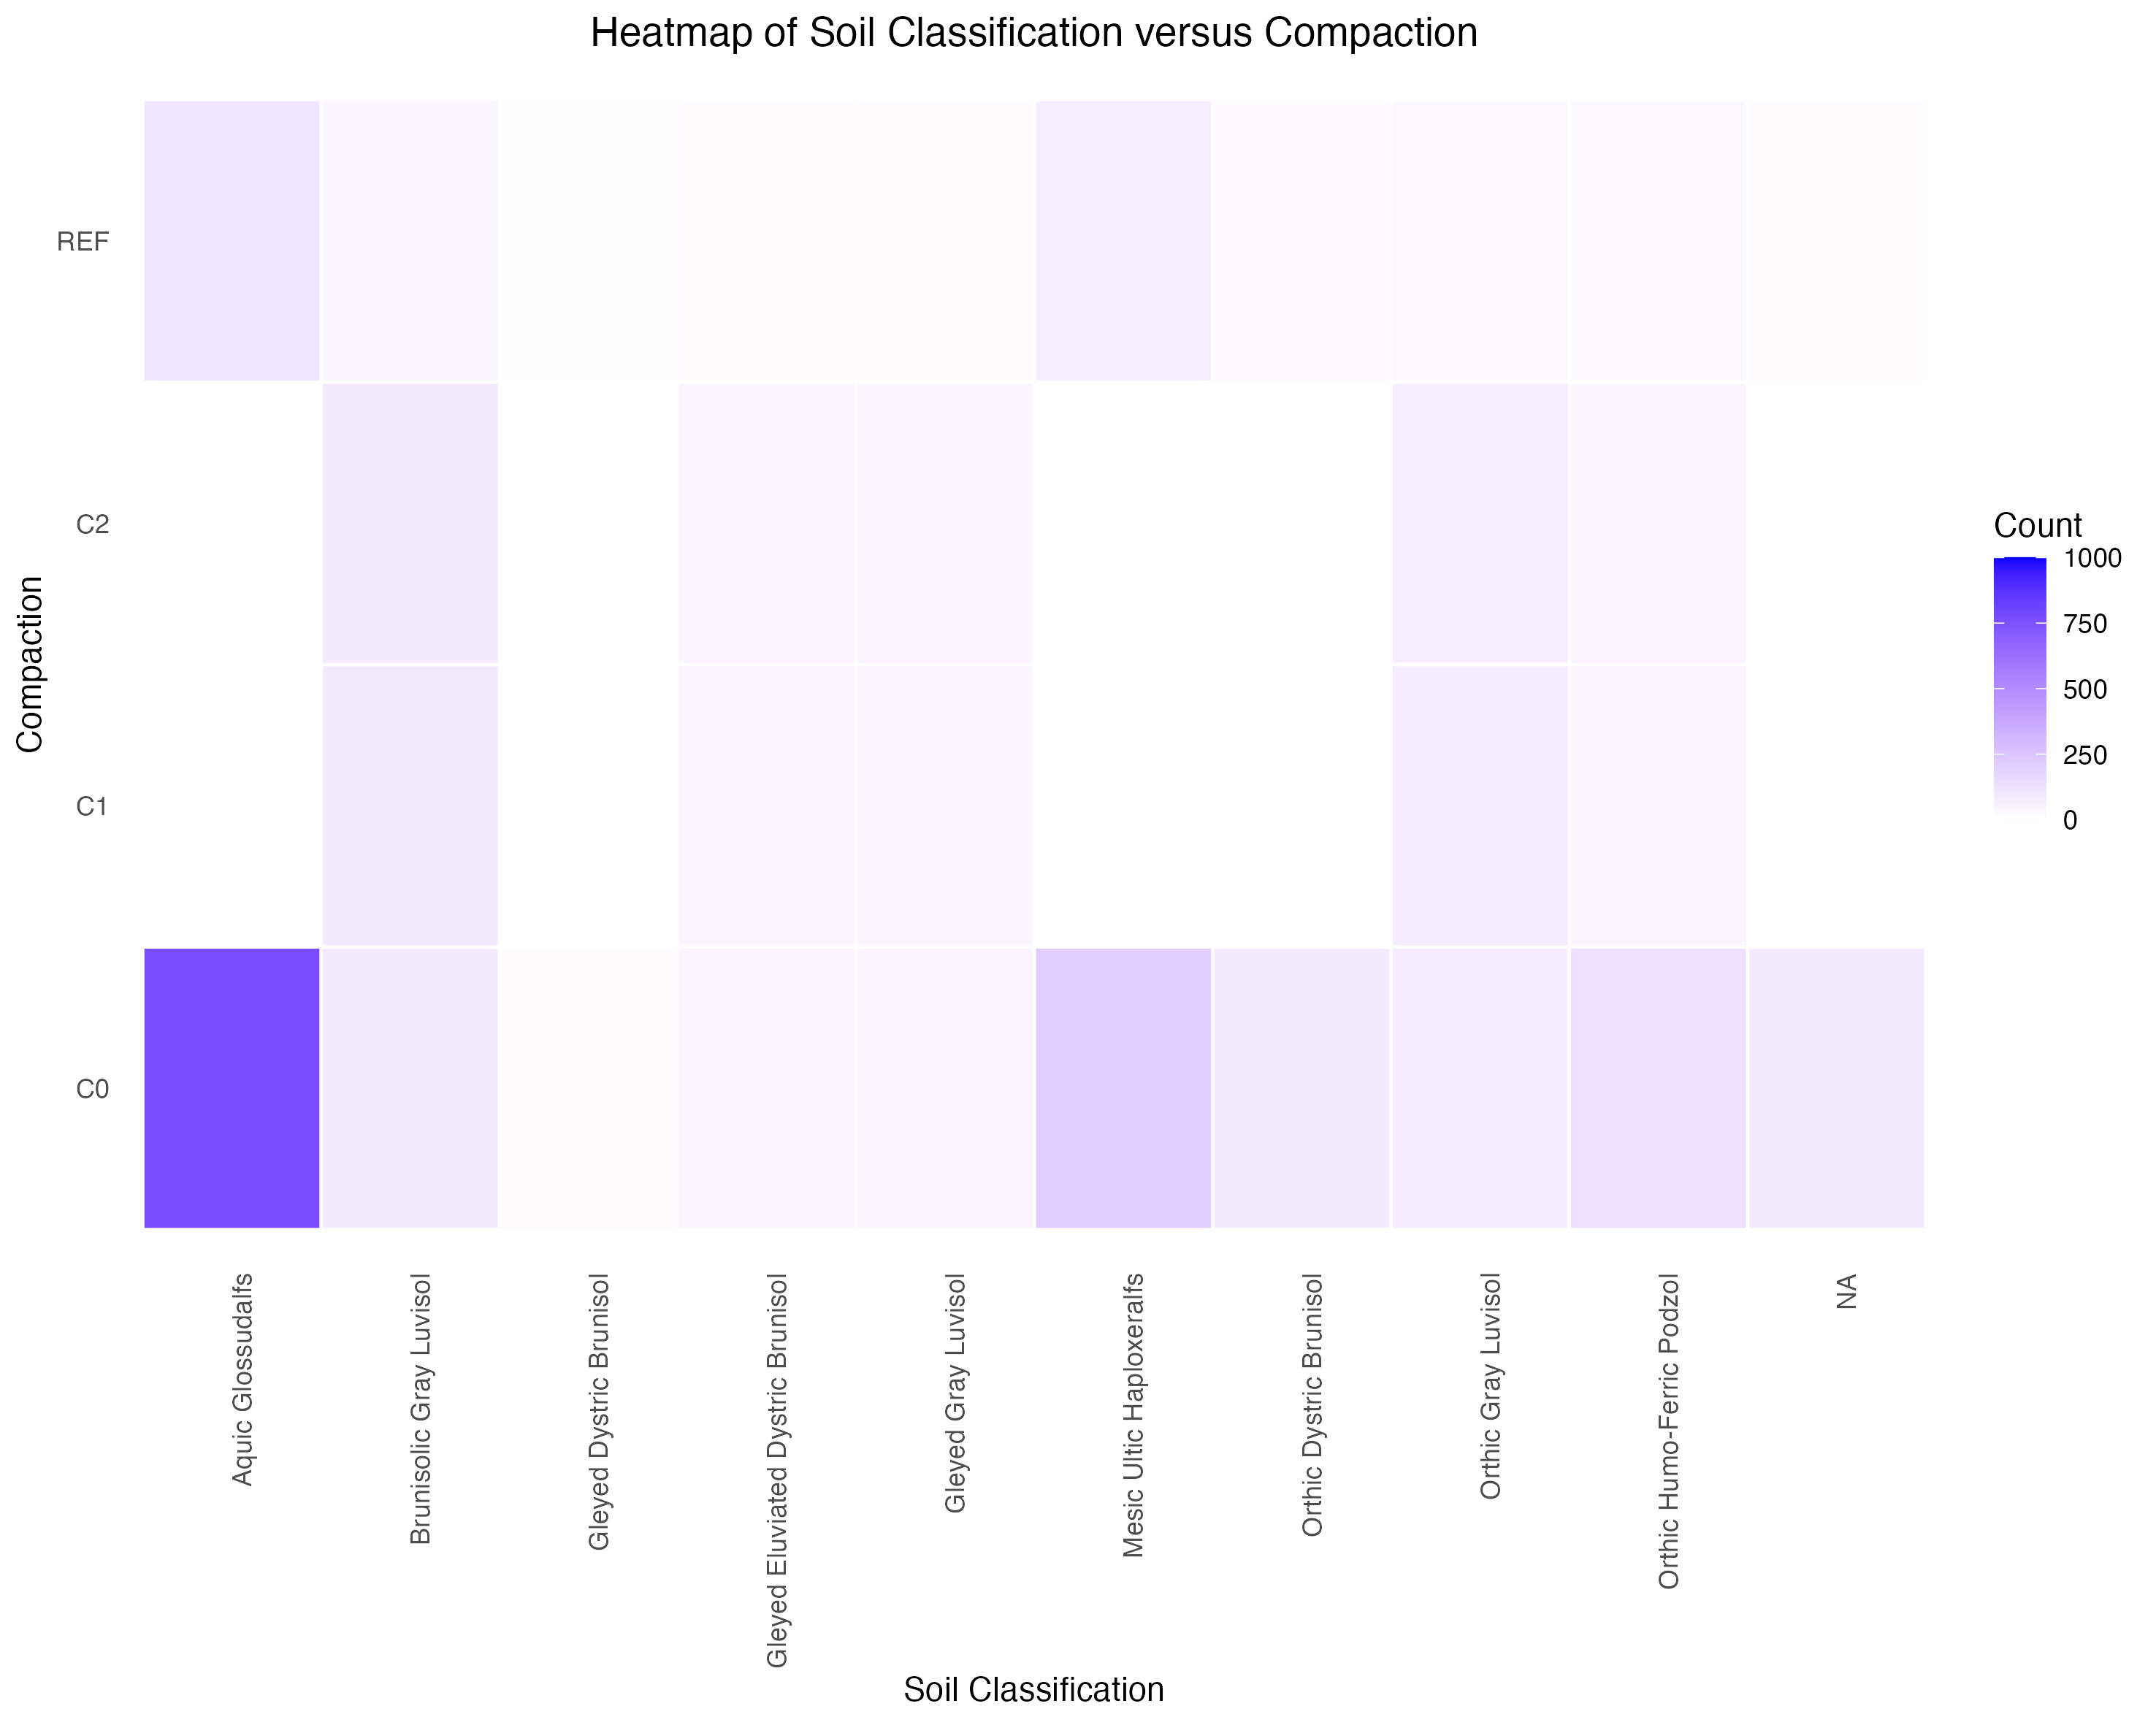
Notes:
Figure 2. Heat Map of Soil Classification and Compaction Treatment. Aquic Glossudalfs, Mesic Ultic Haploxeraifs, and Orthic Humo-Ferric Podzal correlate most with C0. The remaining soil classifications don't appear to correlate with a particular compaction treatment.

Slide 33
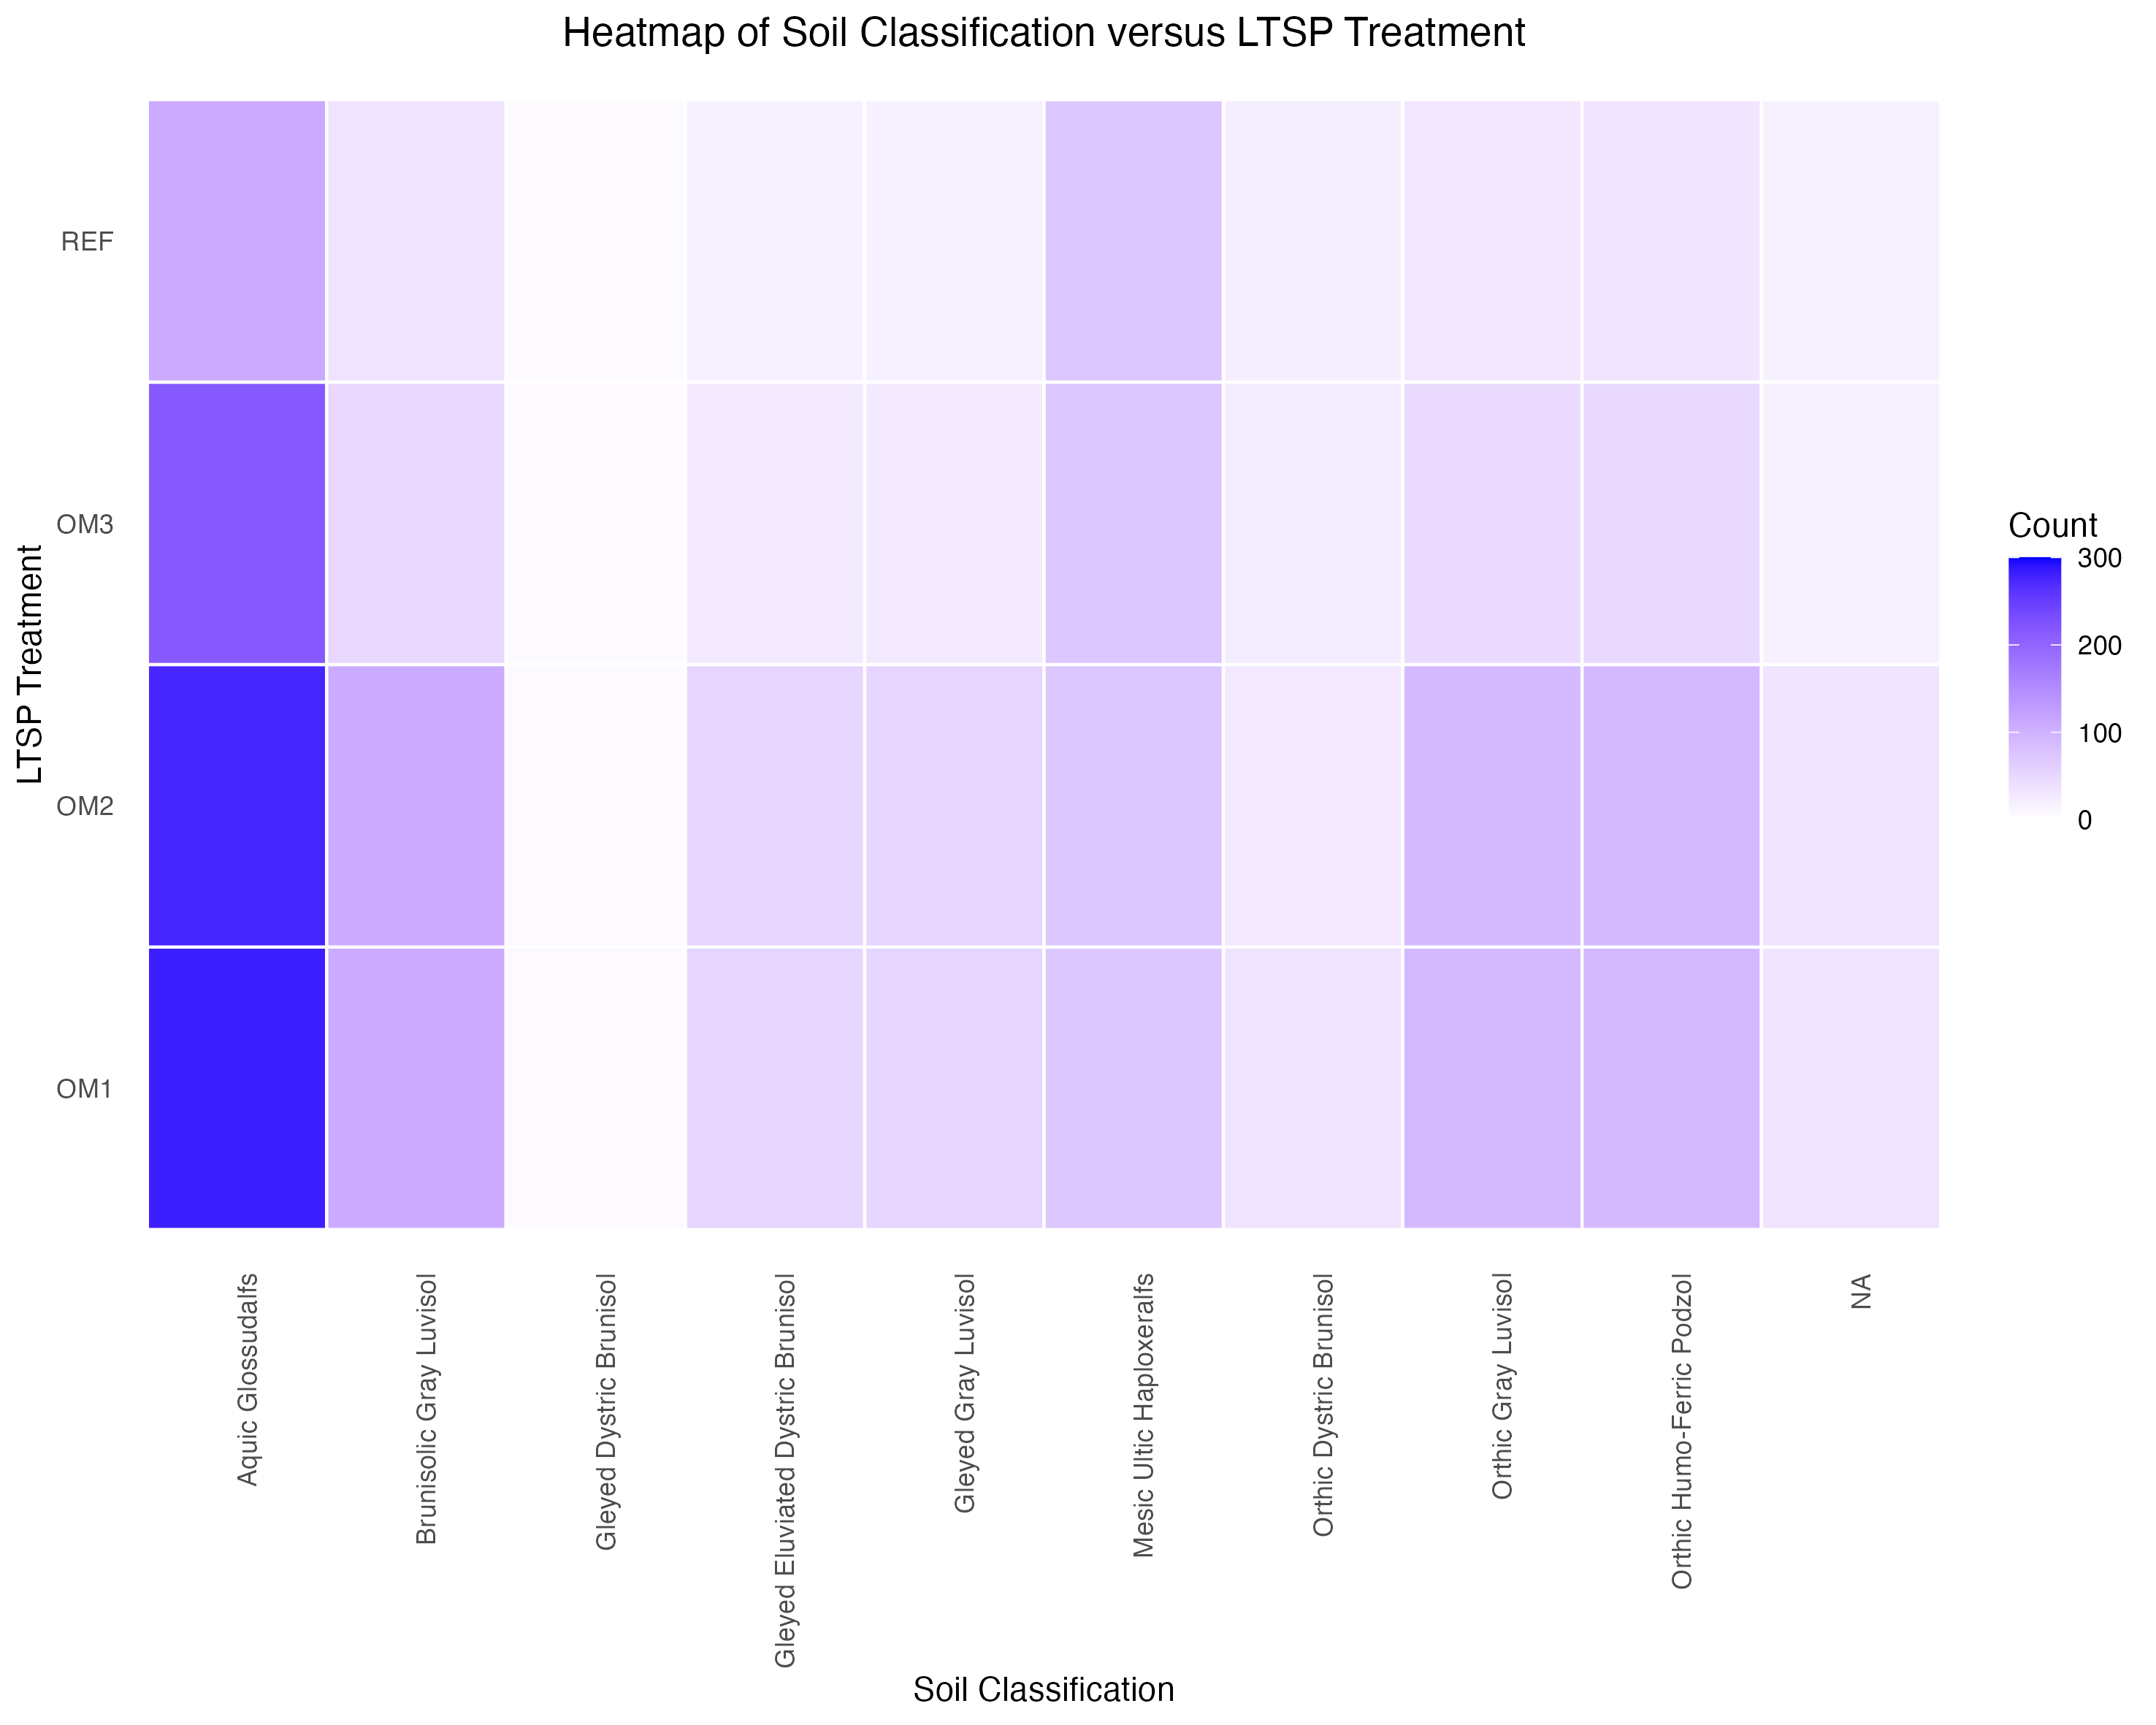
Notes:
Figure 3. Heat Map of Soil Classification and LTSP Treatment. The majority of soil classifications appear to correlate most with OM1 and OM2. The exceptions are Mesic Ultic Haploxeraifs (which appears to correlates most with REF) and Gleyed Dystric Brunisol (which doesn't appear to have any correlation).

Slide 34
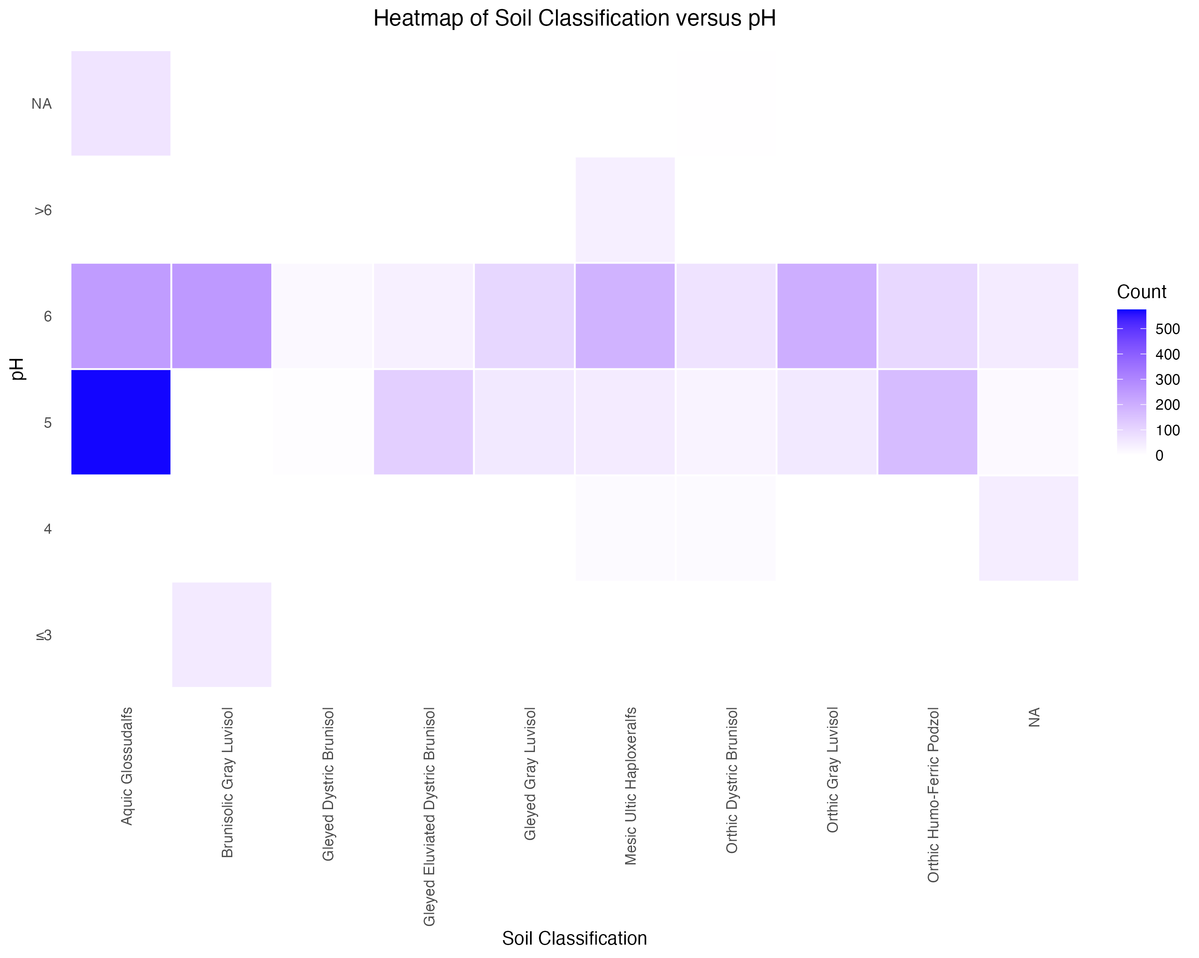
Notes:
Figure 4. Heat Map of Soil Classification and pH. Aquic Glossudalfs, Gleyed Eluviated Dystric Brunisol, and Orthic Humo-Ferric Podzol are most correlated with a pH of 5. Brunisolic Gray Luvisol, Gleyed Gray Luvisol, Mesic Ultic Haploseralfs, Orthic Dystric Brunisol, and Orthic Gray Luvisol are most correlated with a pH of 6. Gleyed Dystric Brunisol does not appear to be correlated with a specific pH.

Slide 35
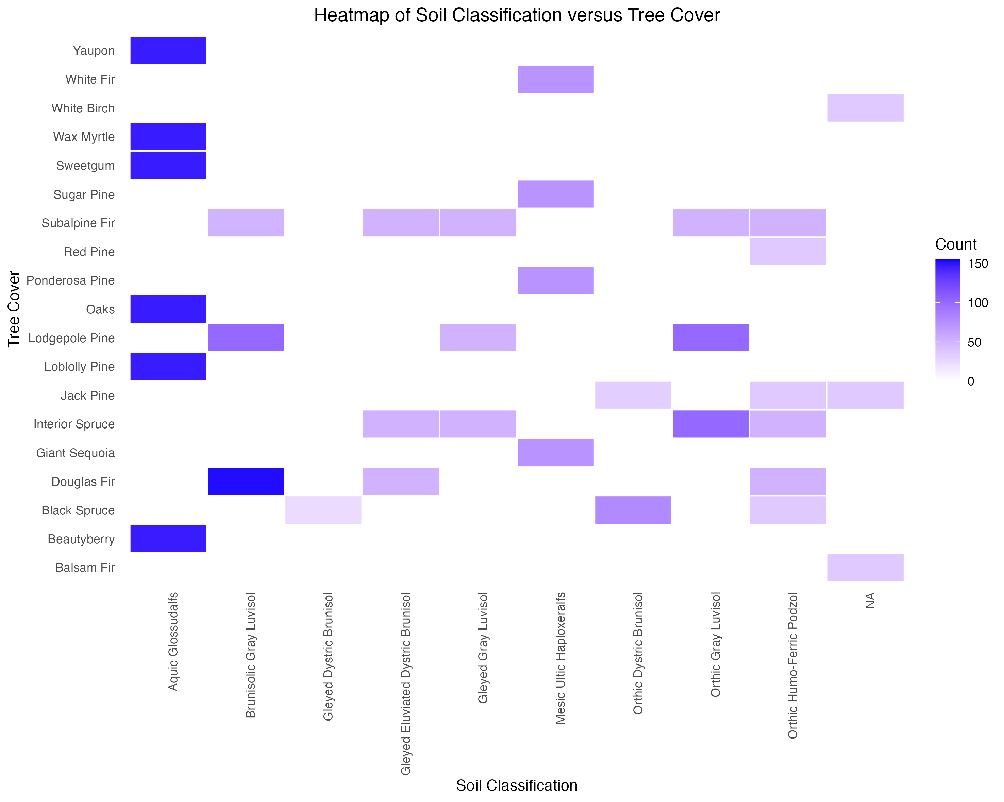
Notes:
Figure 5. Heat Map of Soil Classification and Tree Cover. The highest correlations occur between Aquic Glossudalfs with Yaupon, Wax Myrtle, Sweetgum, Oaks, Loblolly Pine, and Beautyberry; and Brunisolic Gray Luvisol with Douglas Fir. Interestingly, Gleyed Dystric Brunisol is only correlated with Black Spruce—other soil classifications are correlated with multiple tree covers.

Slide 36
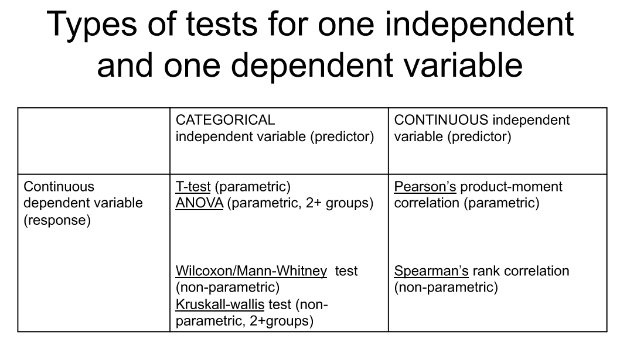

Slide 37
